Slide 1
MobiCom and UbiComp Overview
Swadhin Pradhan
11/07/2018

Slide 2
MobiCom 2018
29th November – 2nd October , 2018

Slide 3
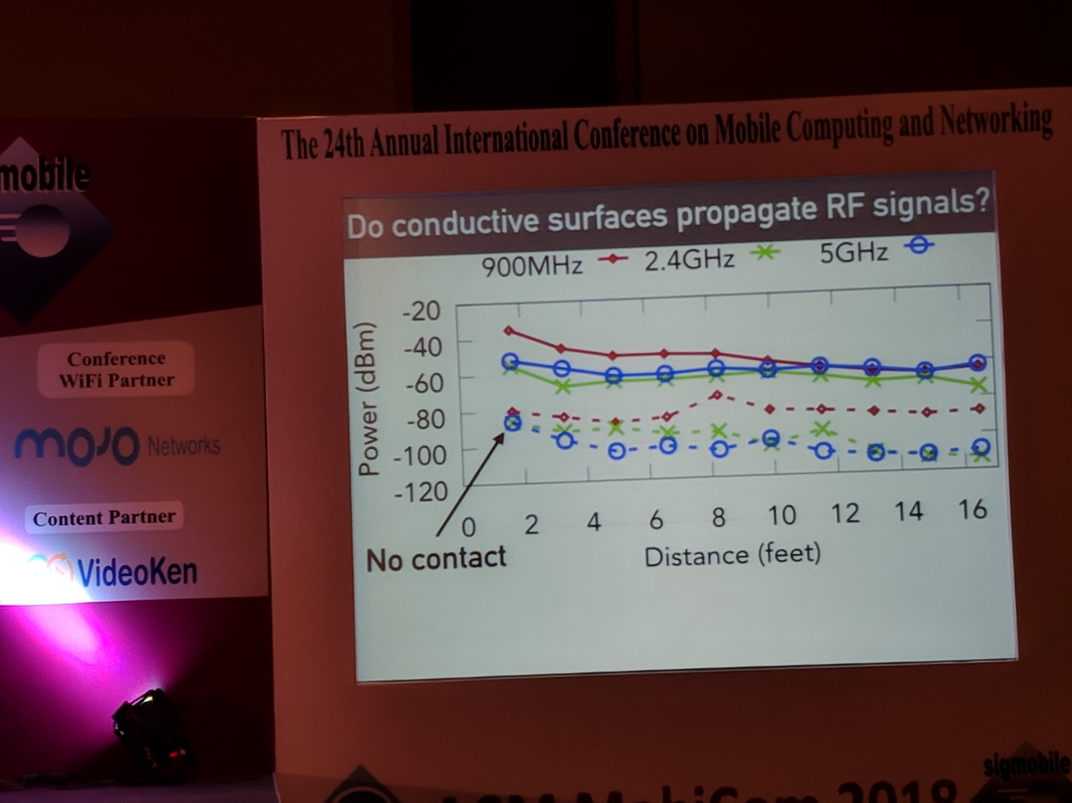
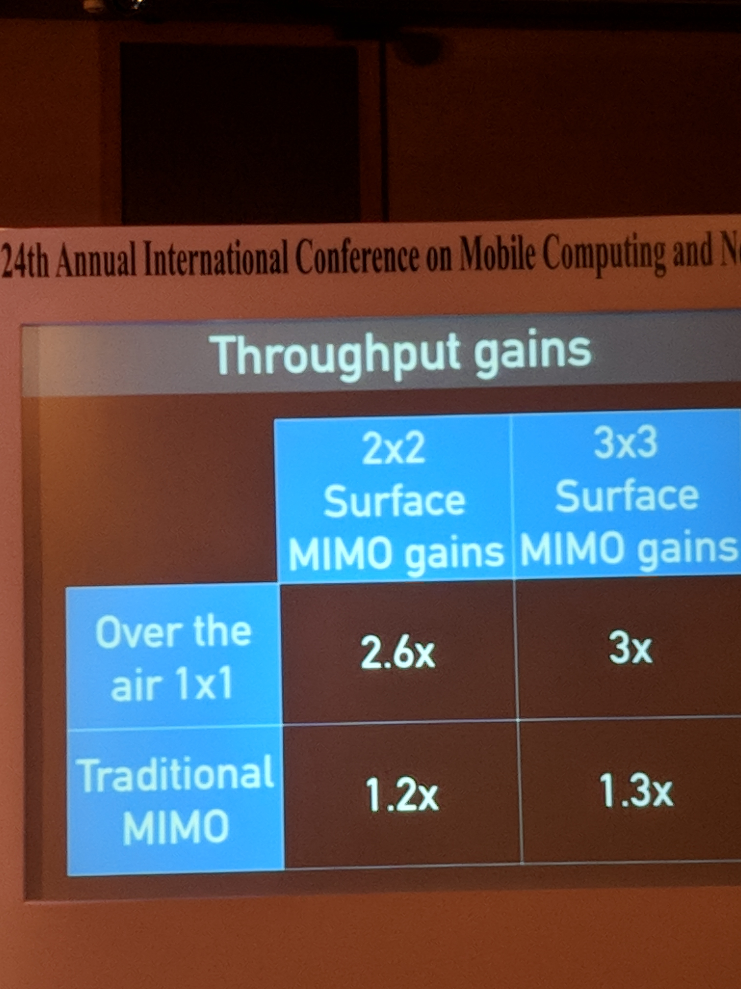
P1: Surface MIMO: Using Conductive Surfaces For MIMO Between Small Devices

Slide 4
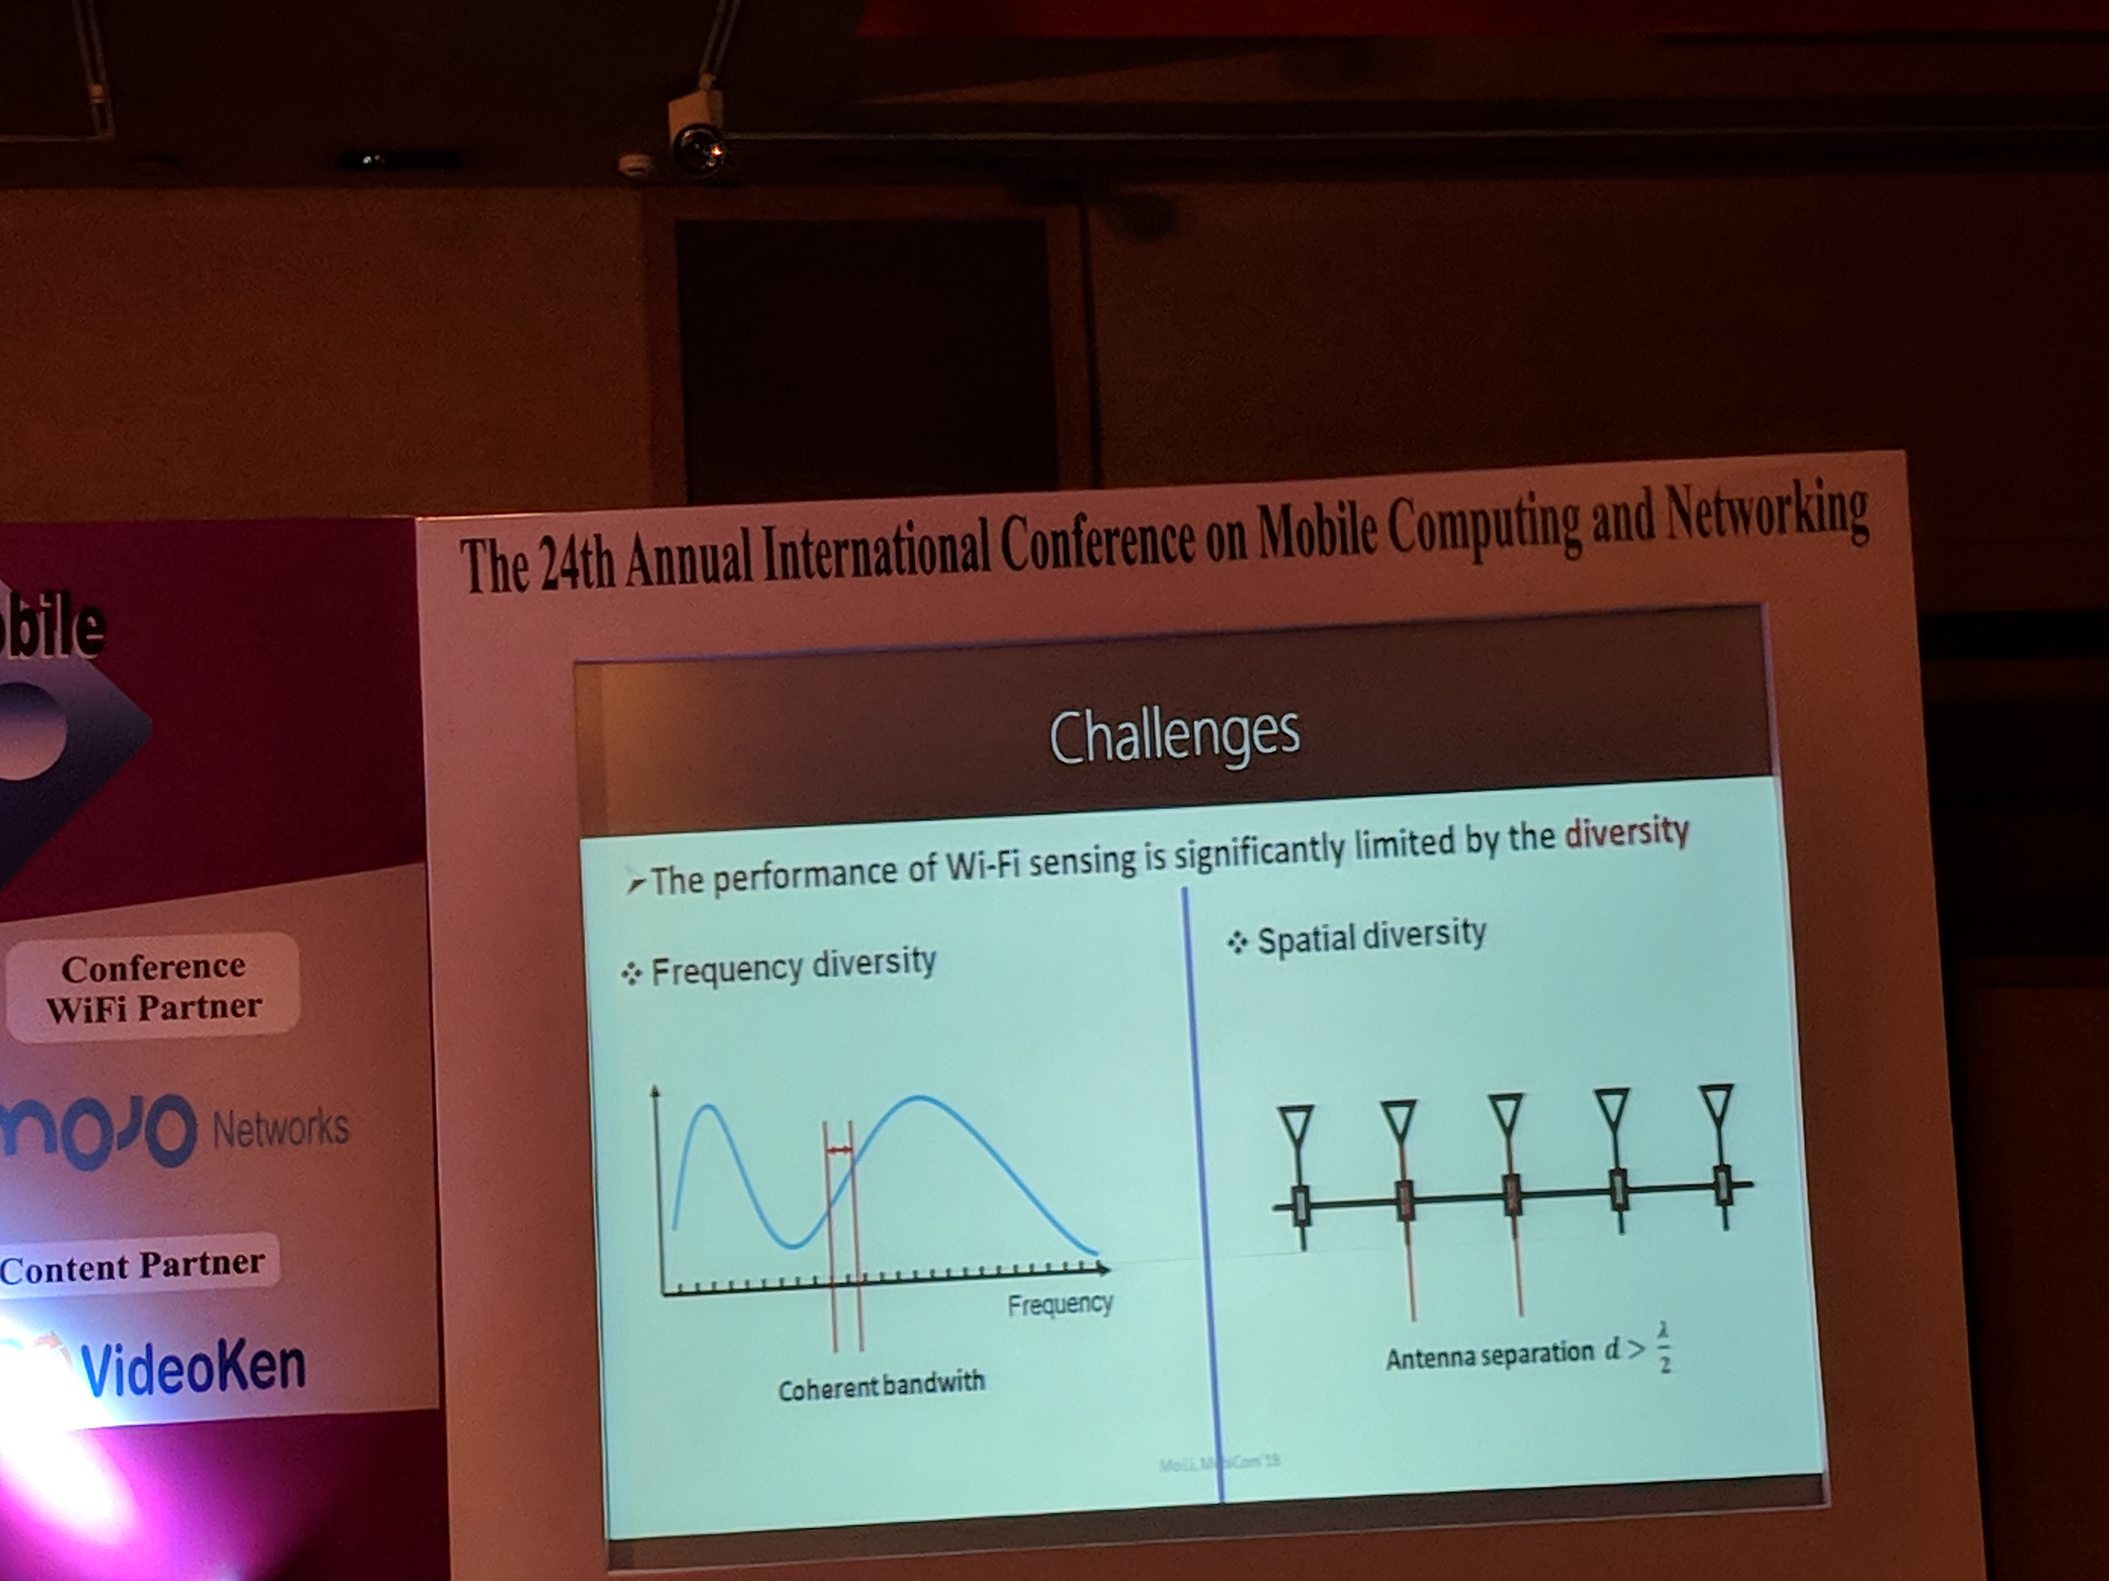
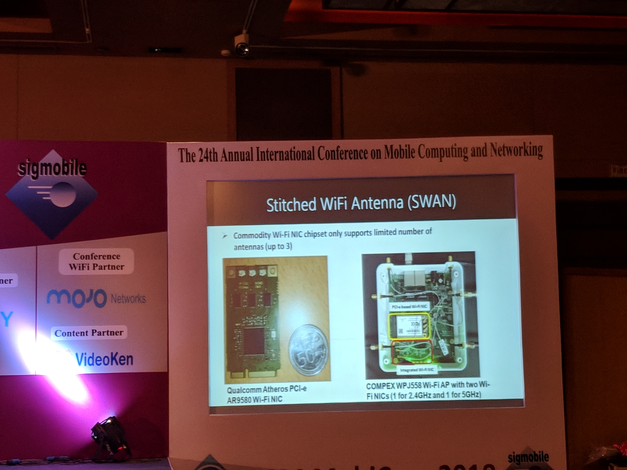
P2: SWAN: Stitched Wi-Fi ANtennas

Slide 5
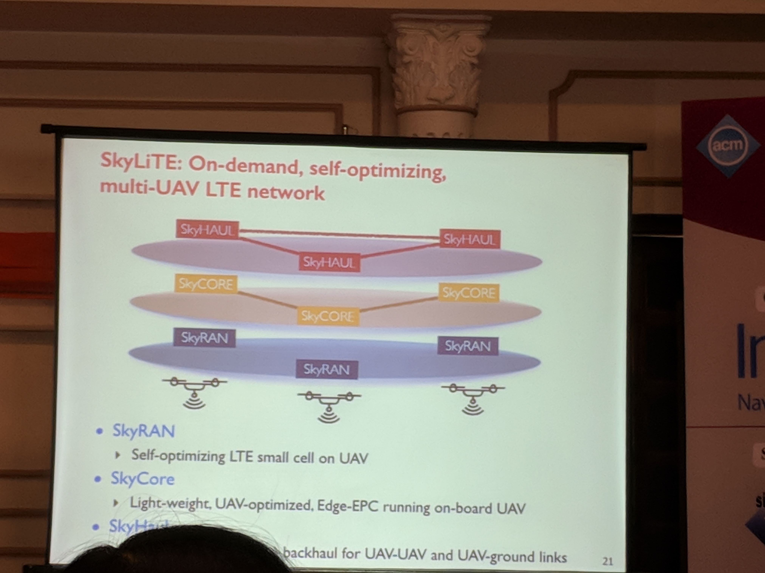
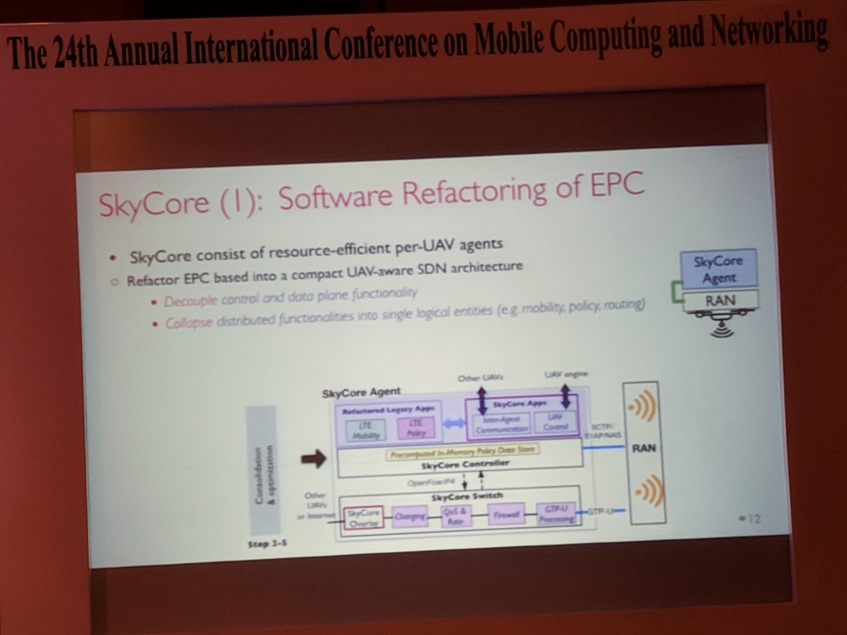
P3: SkyCore*: Moving Core to the Edge for Untethered and Reliable UAV-based LTE networks

Slide 6
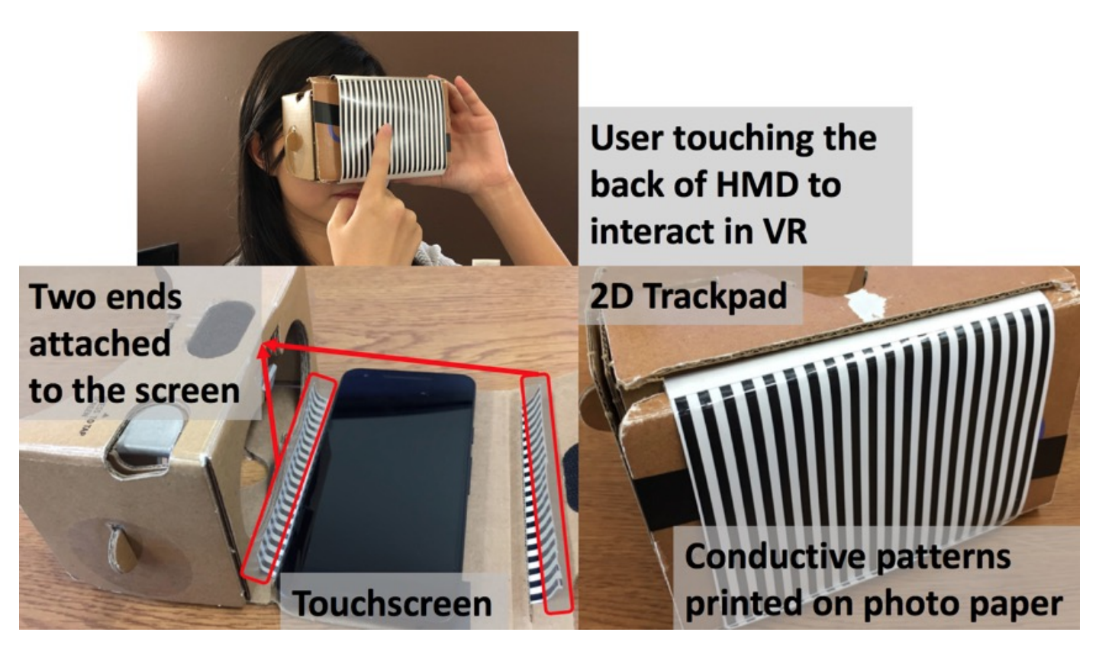
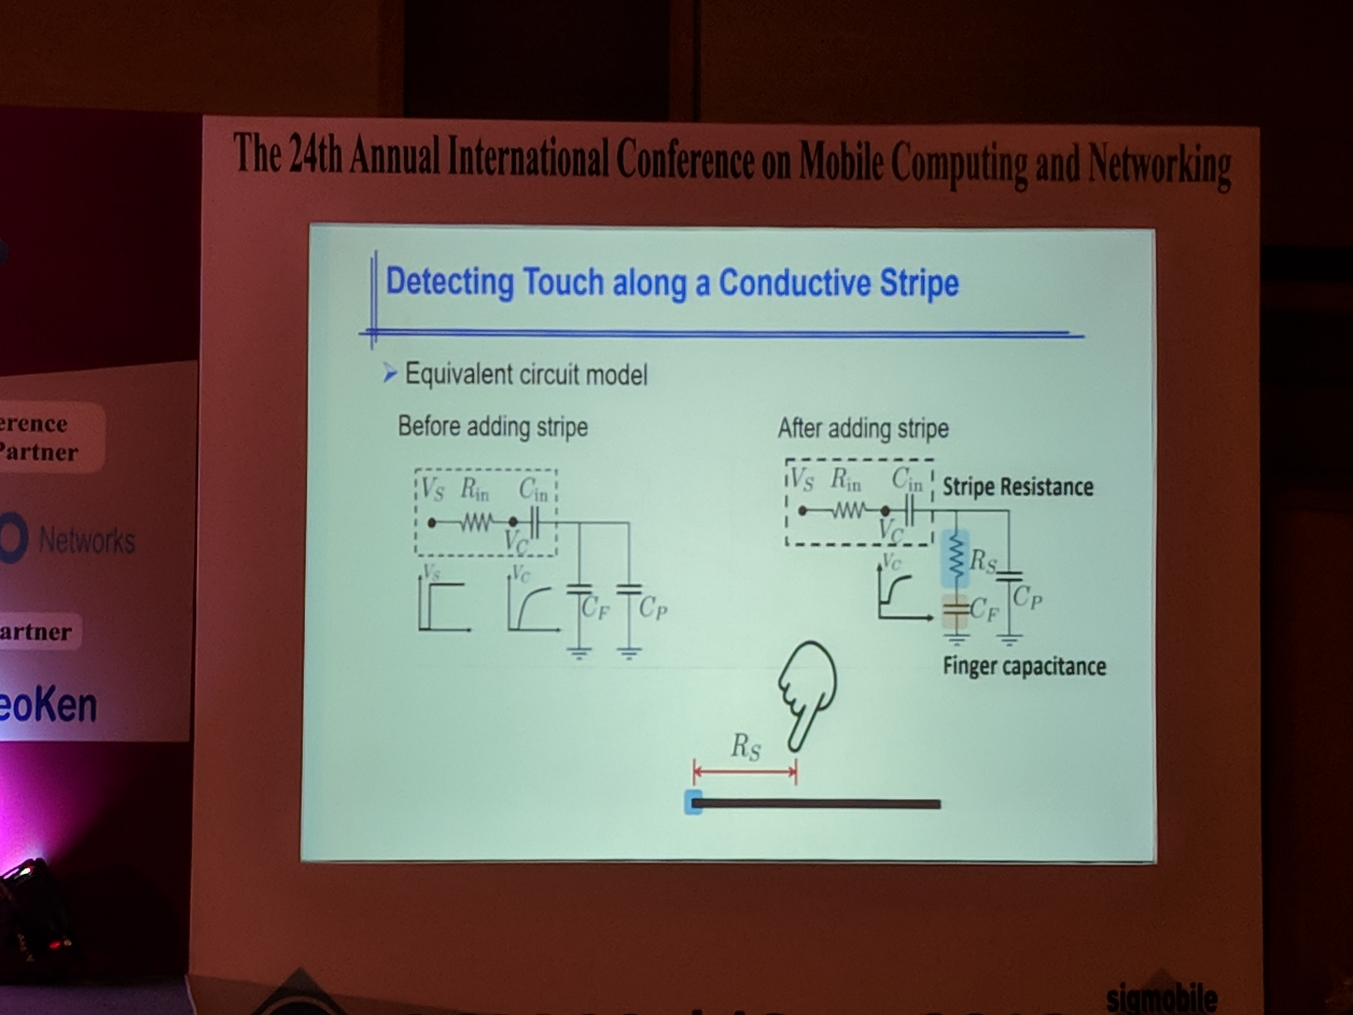
P4:Conductive Inkjet Printed Passive 2D TrackPad for VR Interaction

Slide 7
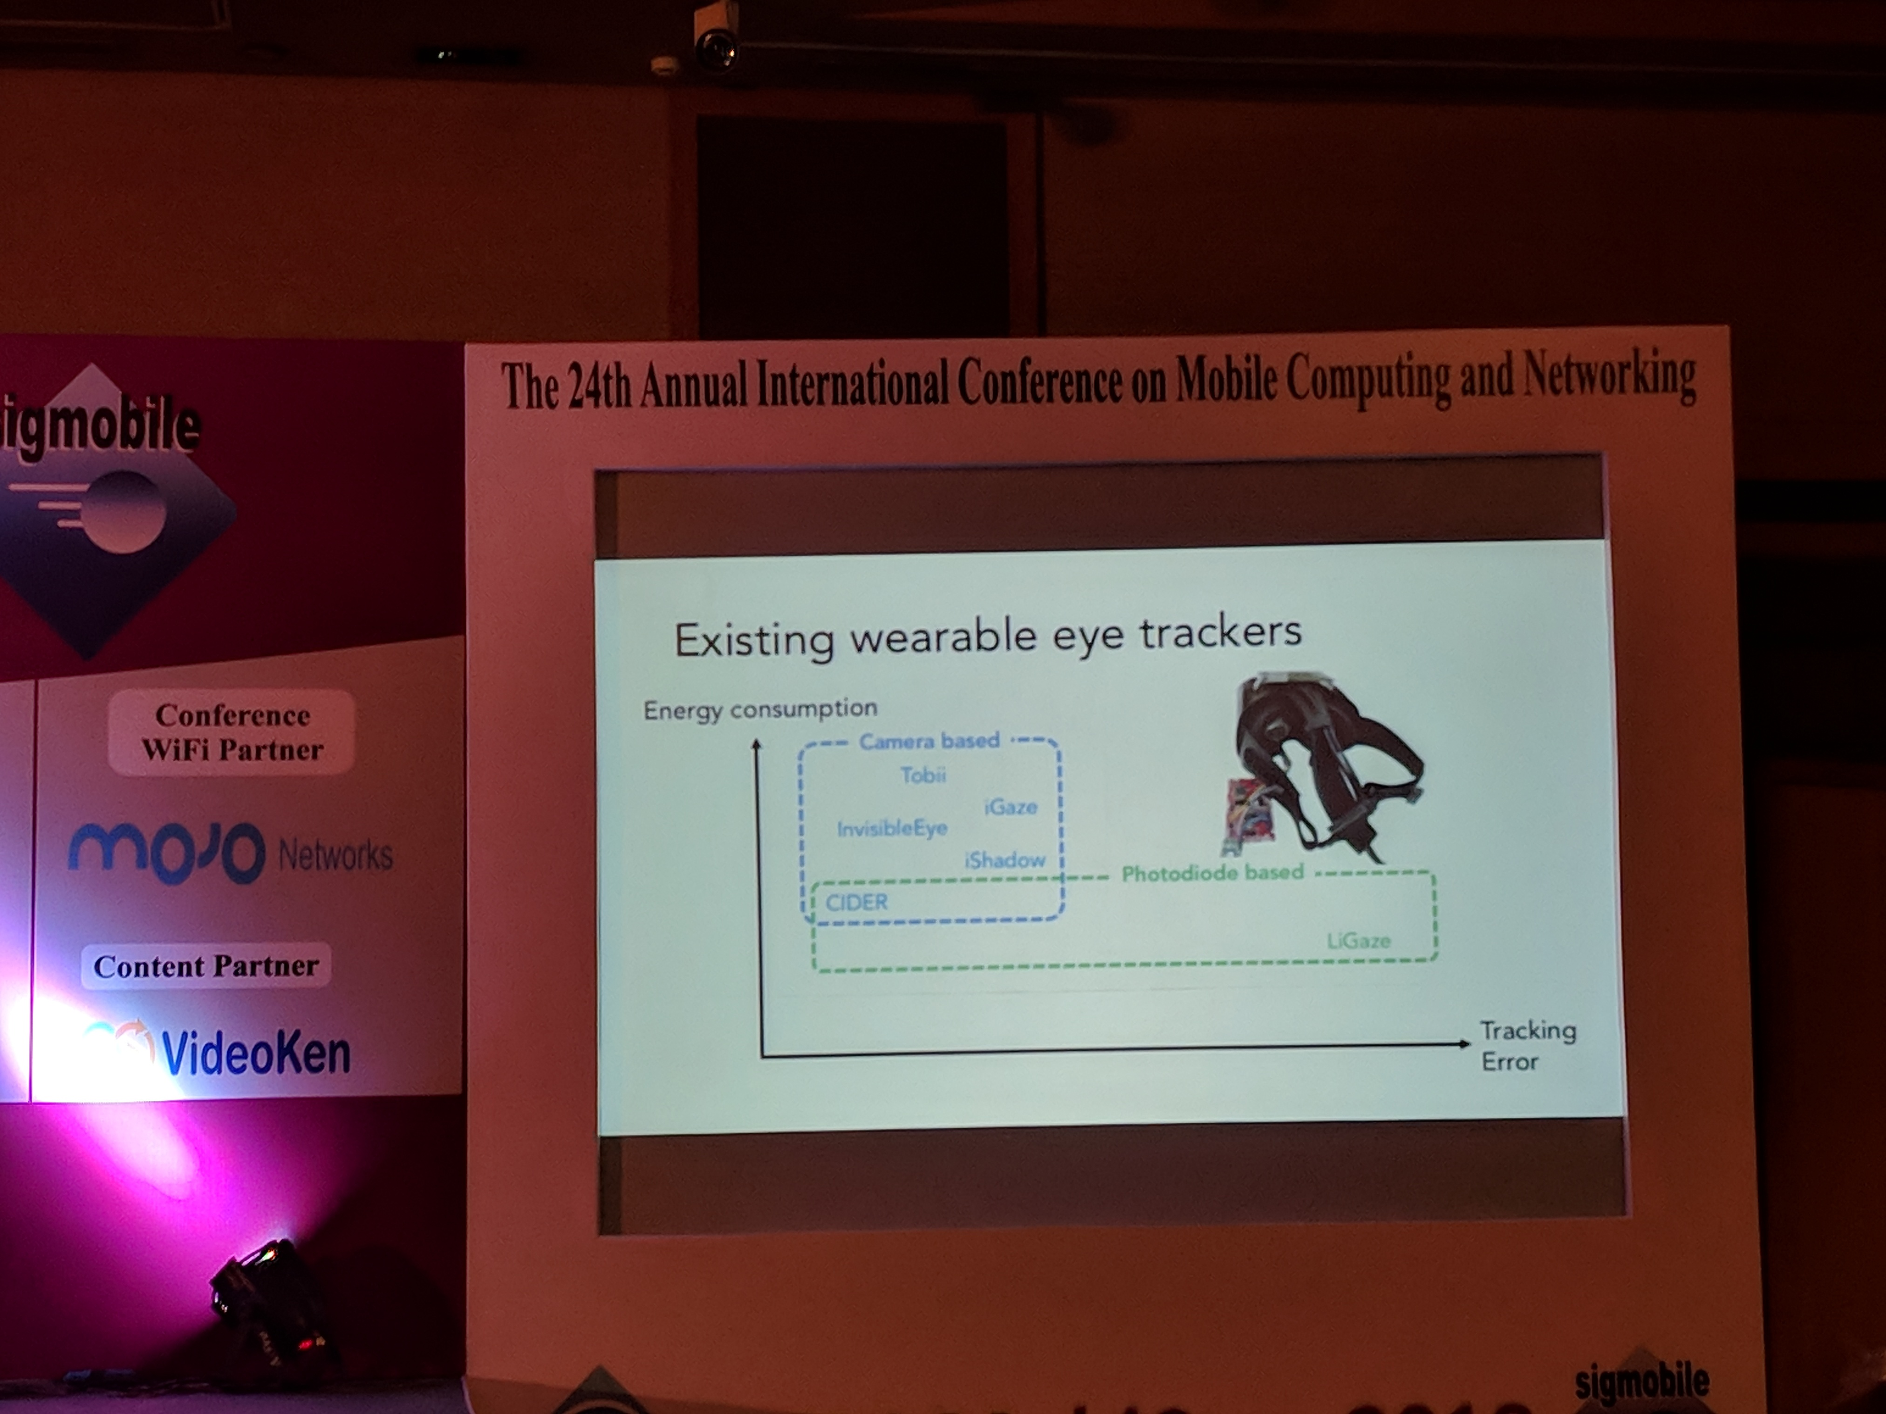
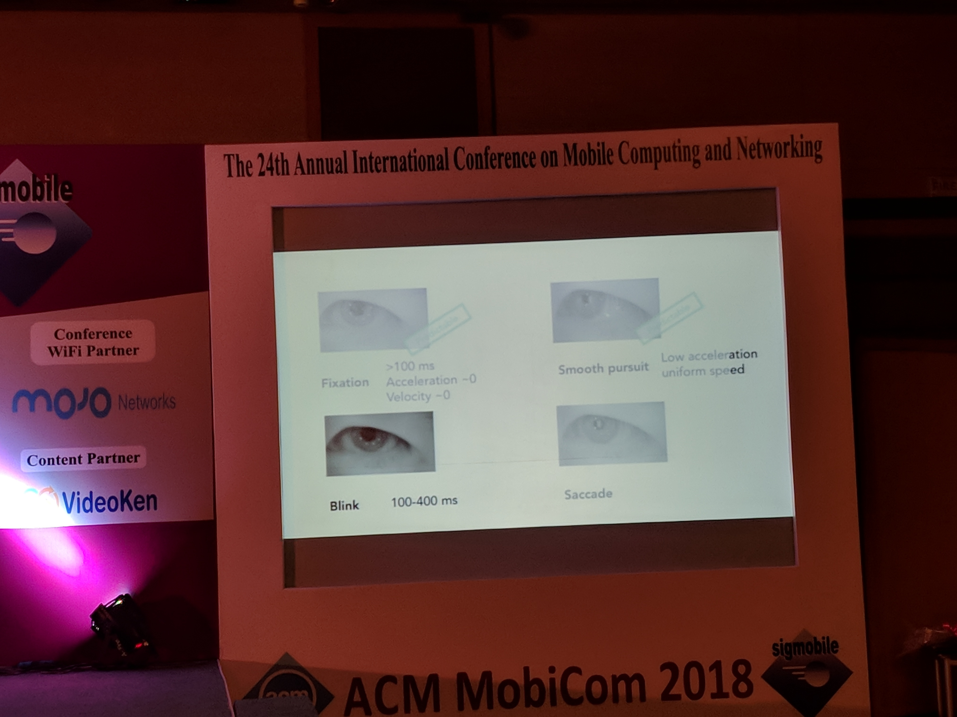
P5: Battery-Free Eye Tracker on Glasses

Slide 8
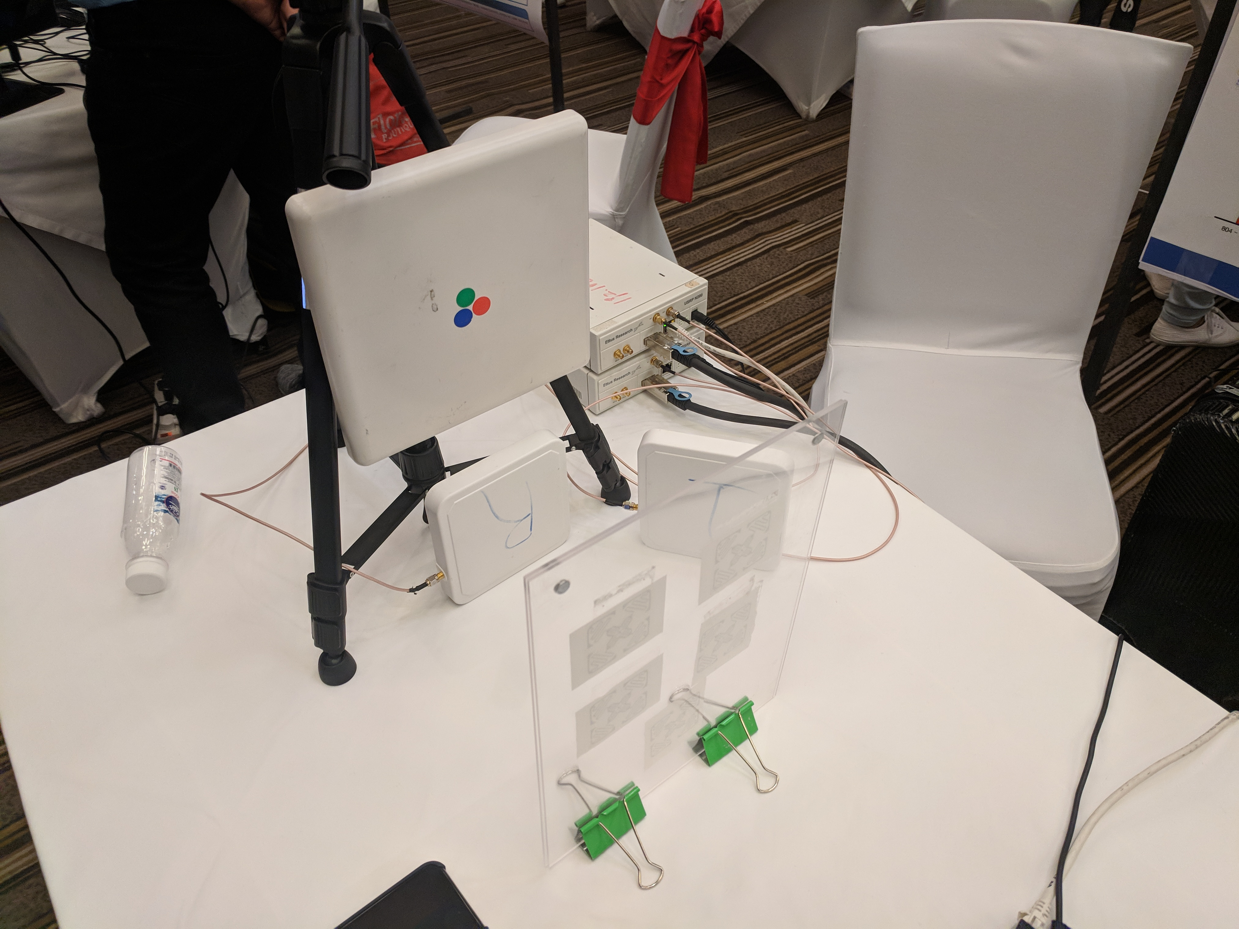
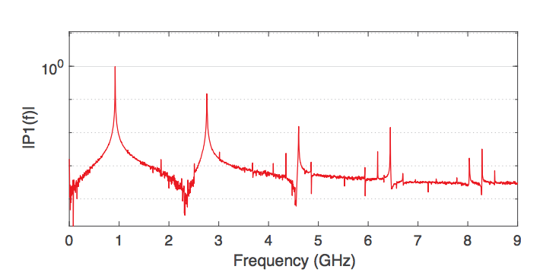
P6:Cross-Frequency Communication: Near-Field Identification of UHF RFIDs with WiFi!

Slide 9
P7:Simultaneous Localization and Mapping with Power Network Electromagnetic Field
Using electromagnetic-field for the building wiring for indoor localization based on finger-printing (showing low temporal change and more spatial diversity)

Slide 10
P8: X-Tandem: Towards Multi-hop Backscatter Using Commodity Wi-Fi
Using multi-hop to read other tags which are not in view
Use FPGA in the tag

Slide 11
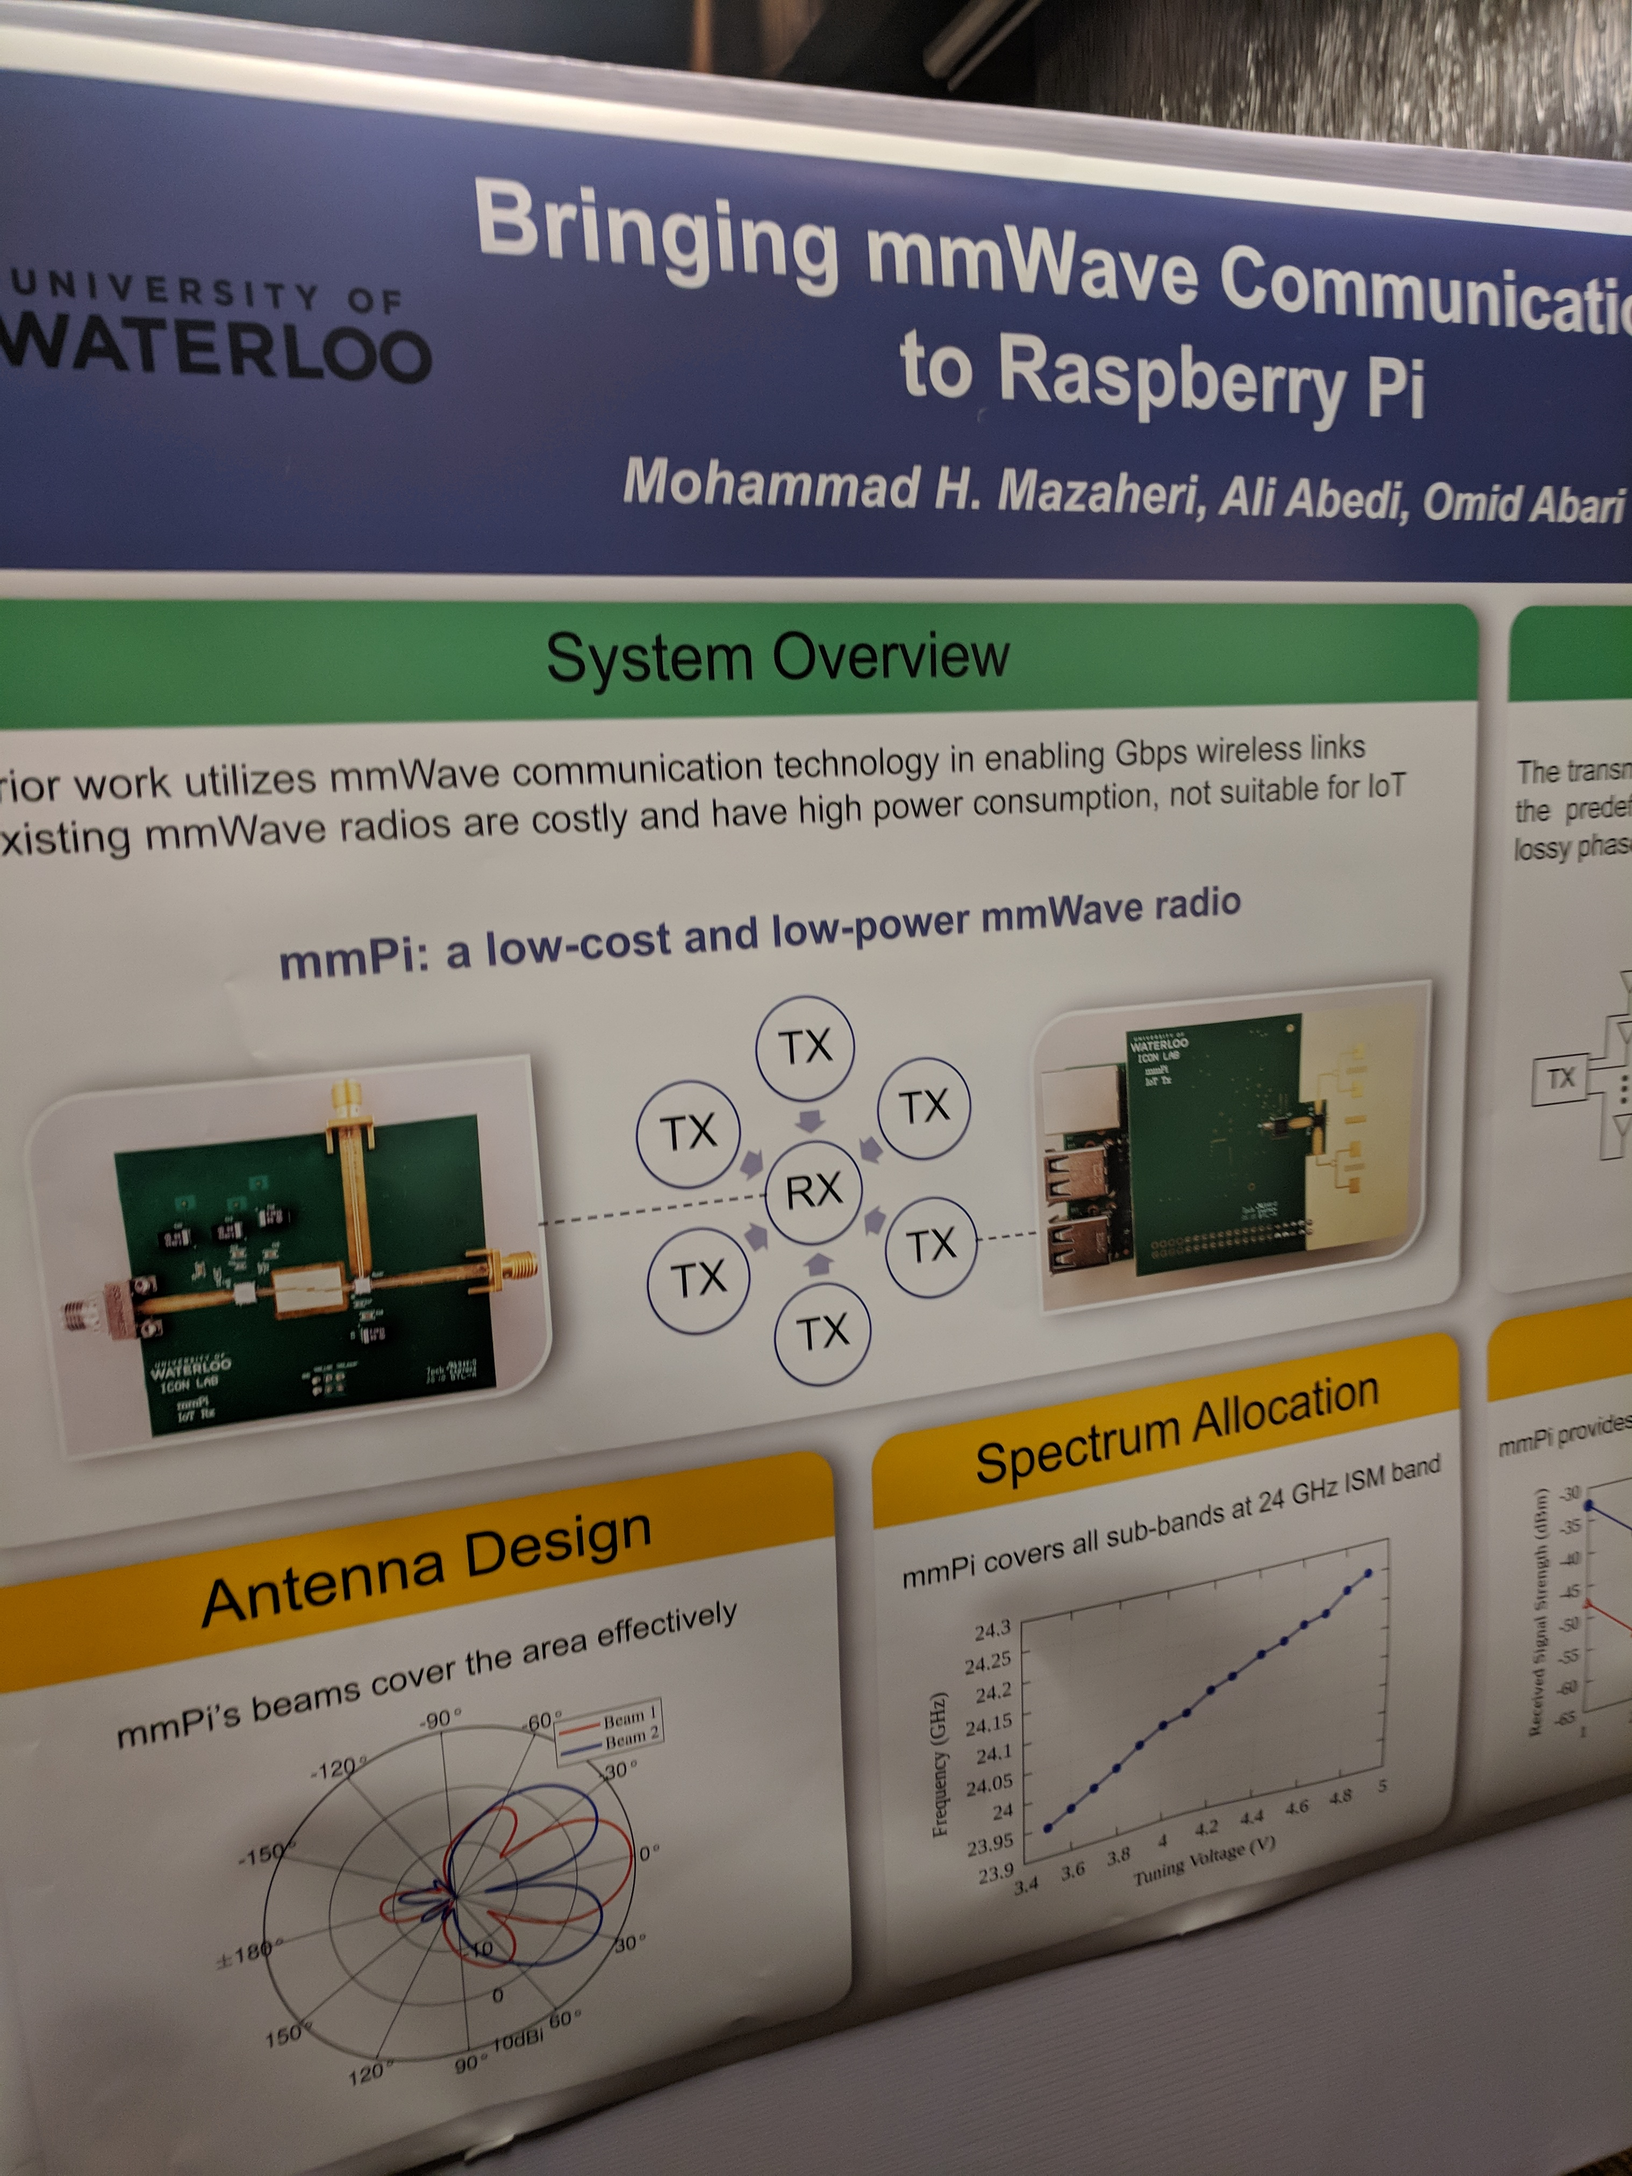
Other: mmWave in RPi

Slide 12
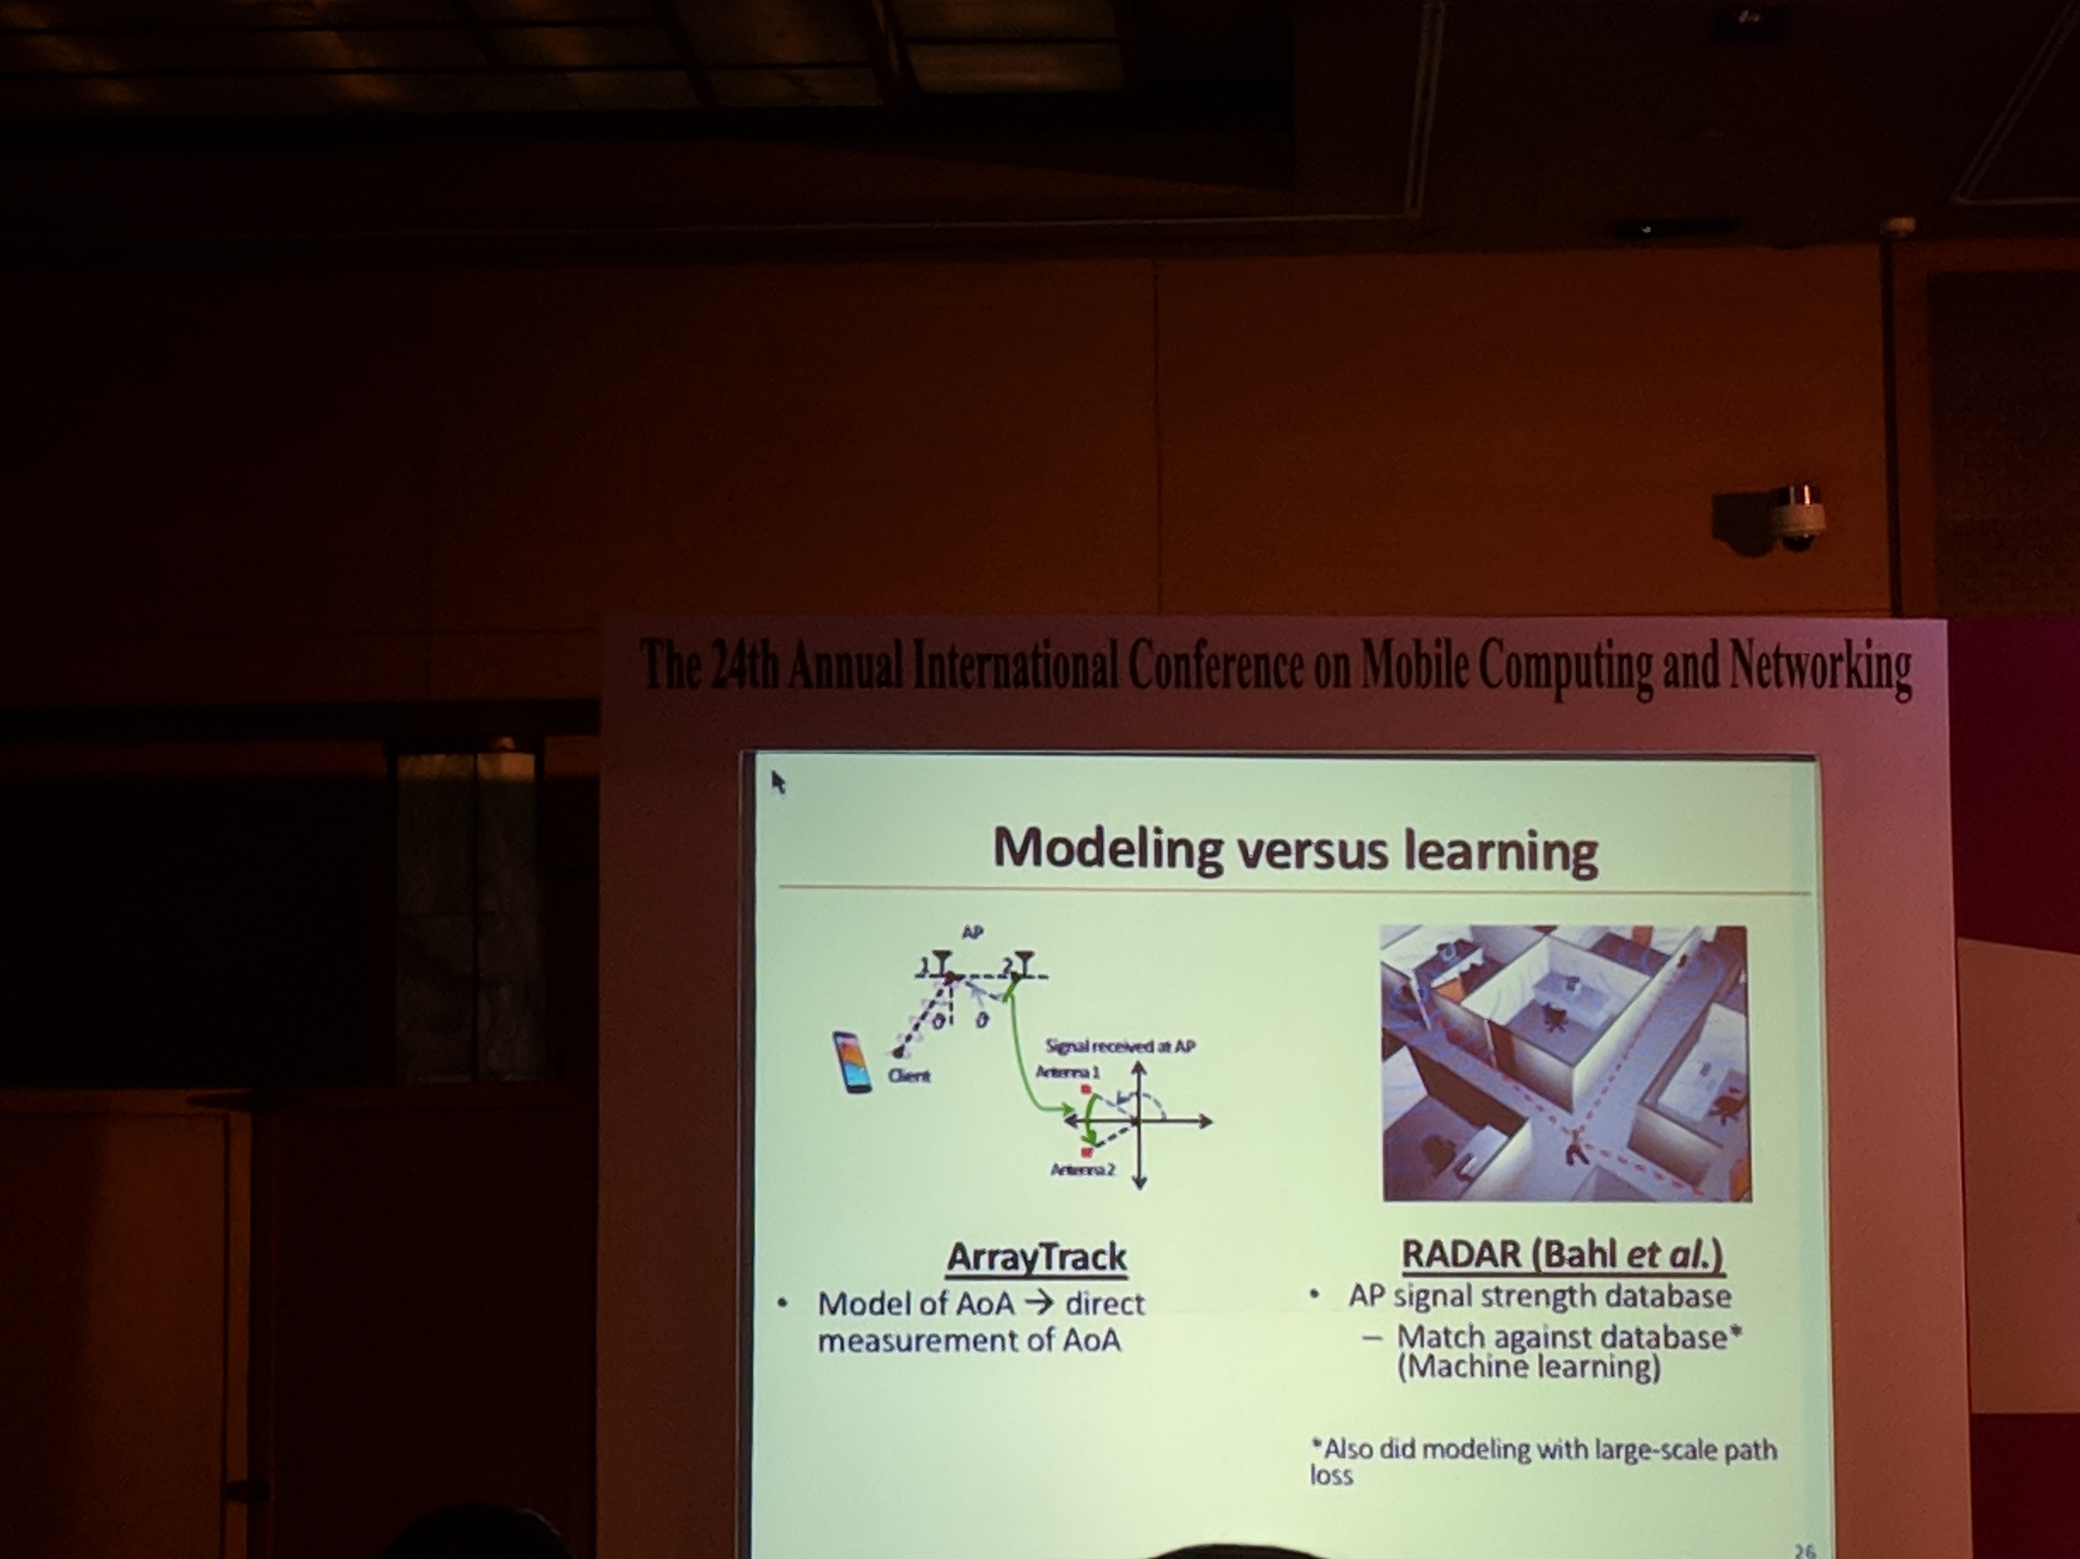
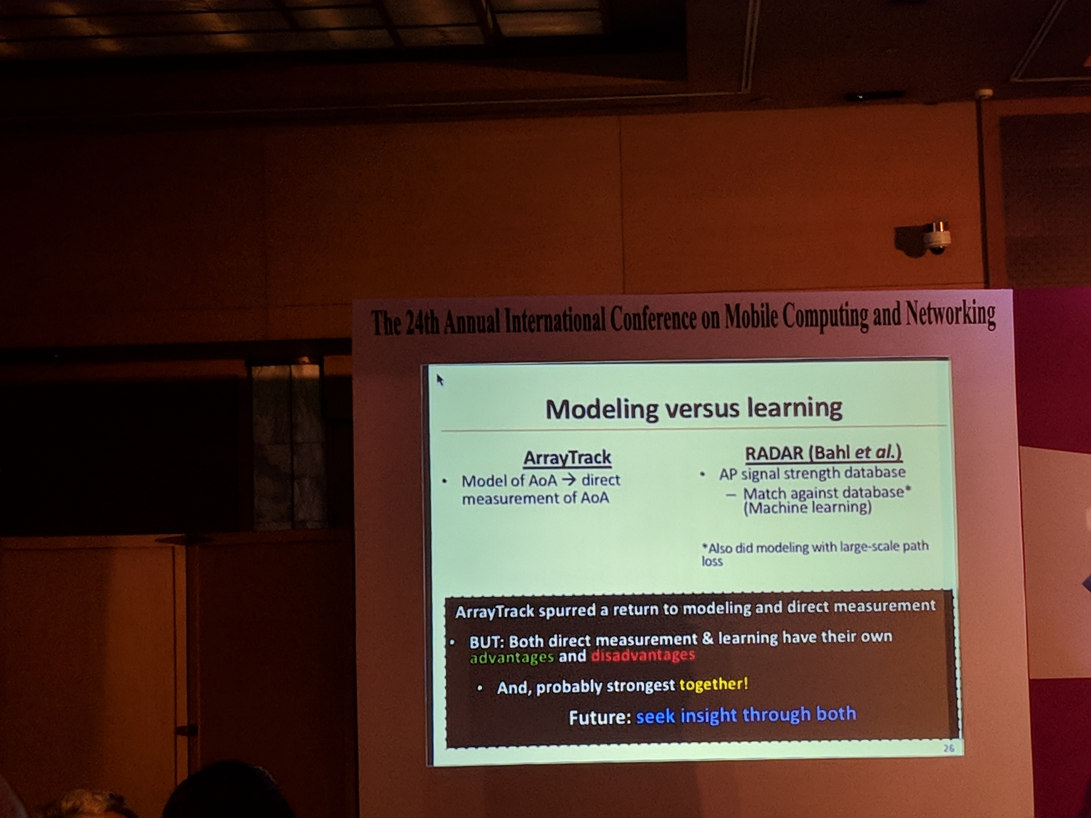
Other: Modeling vs Learning

Slide 13
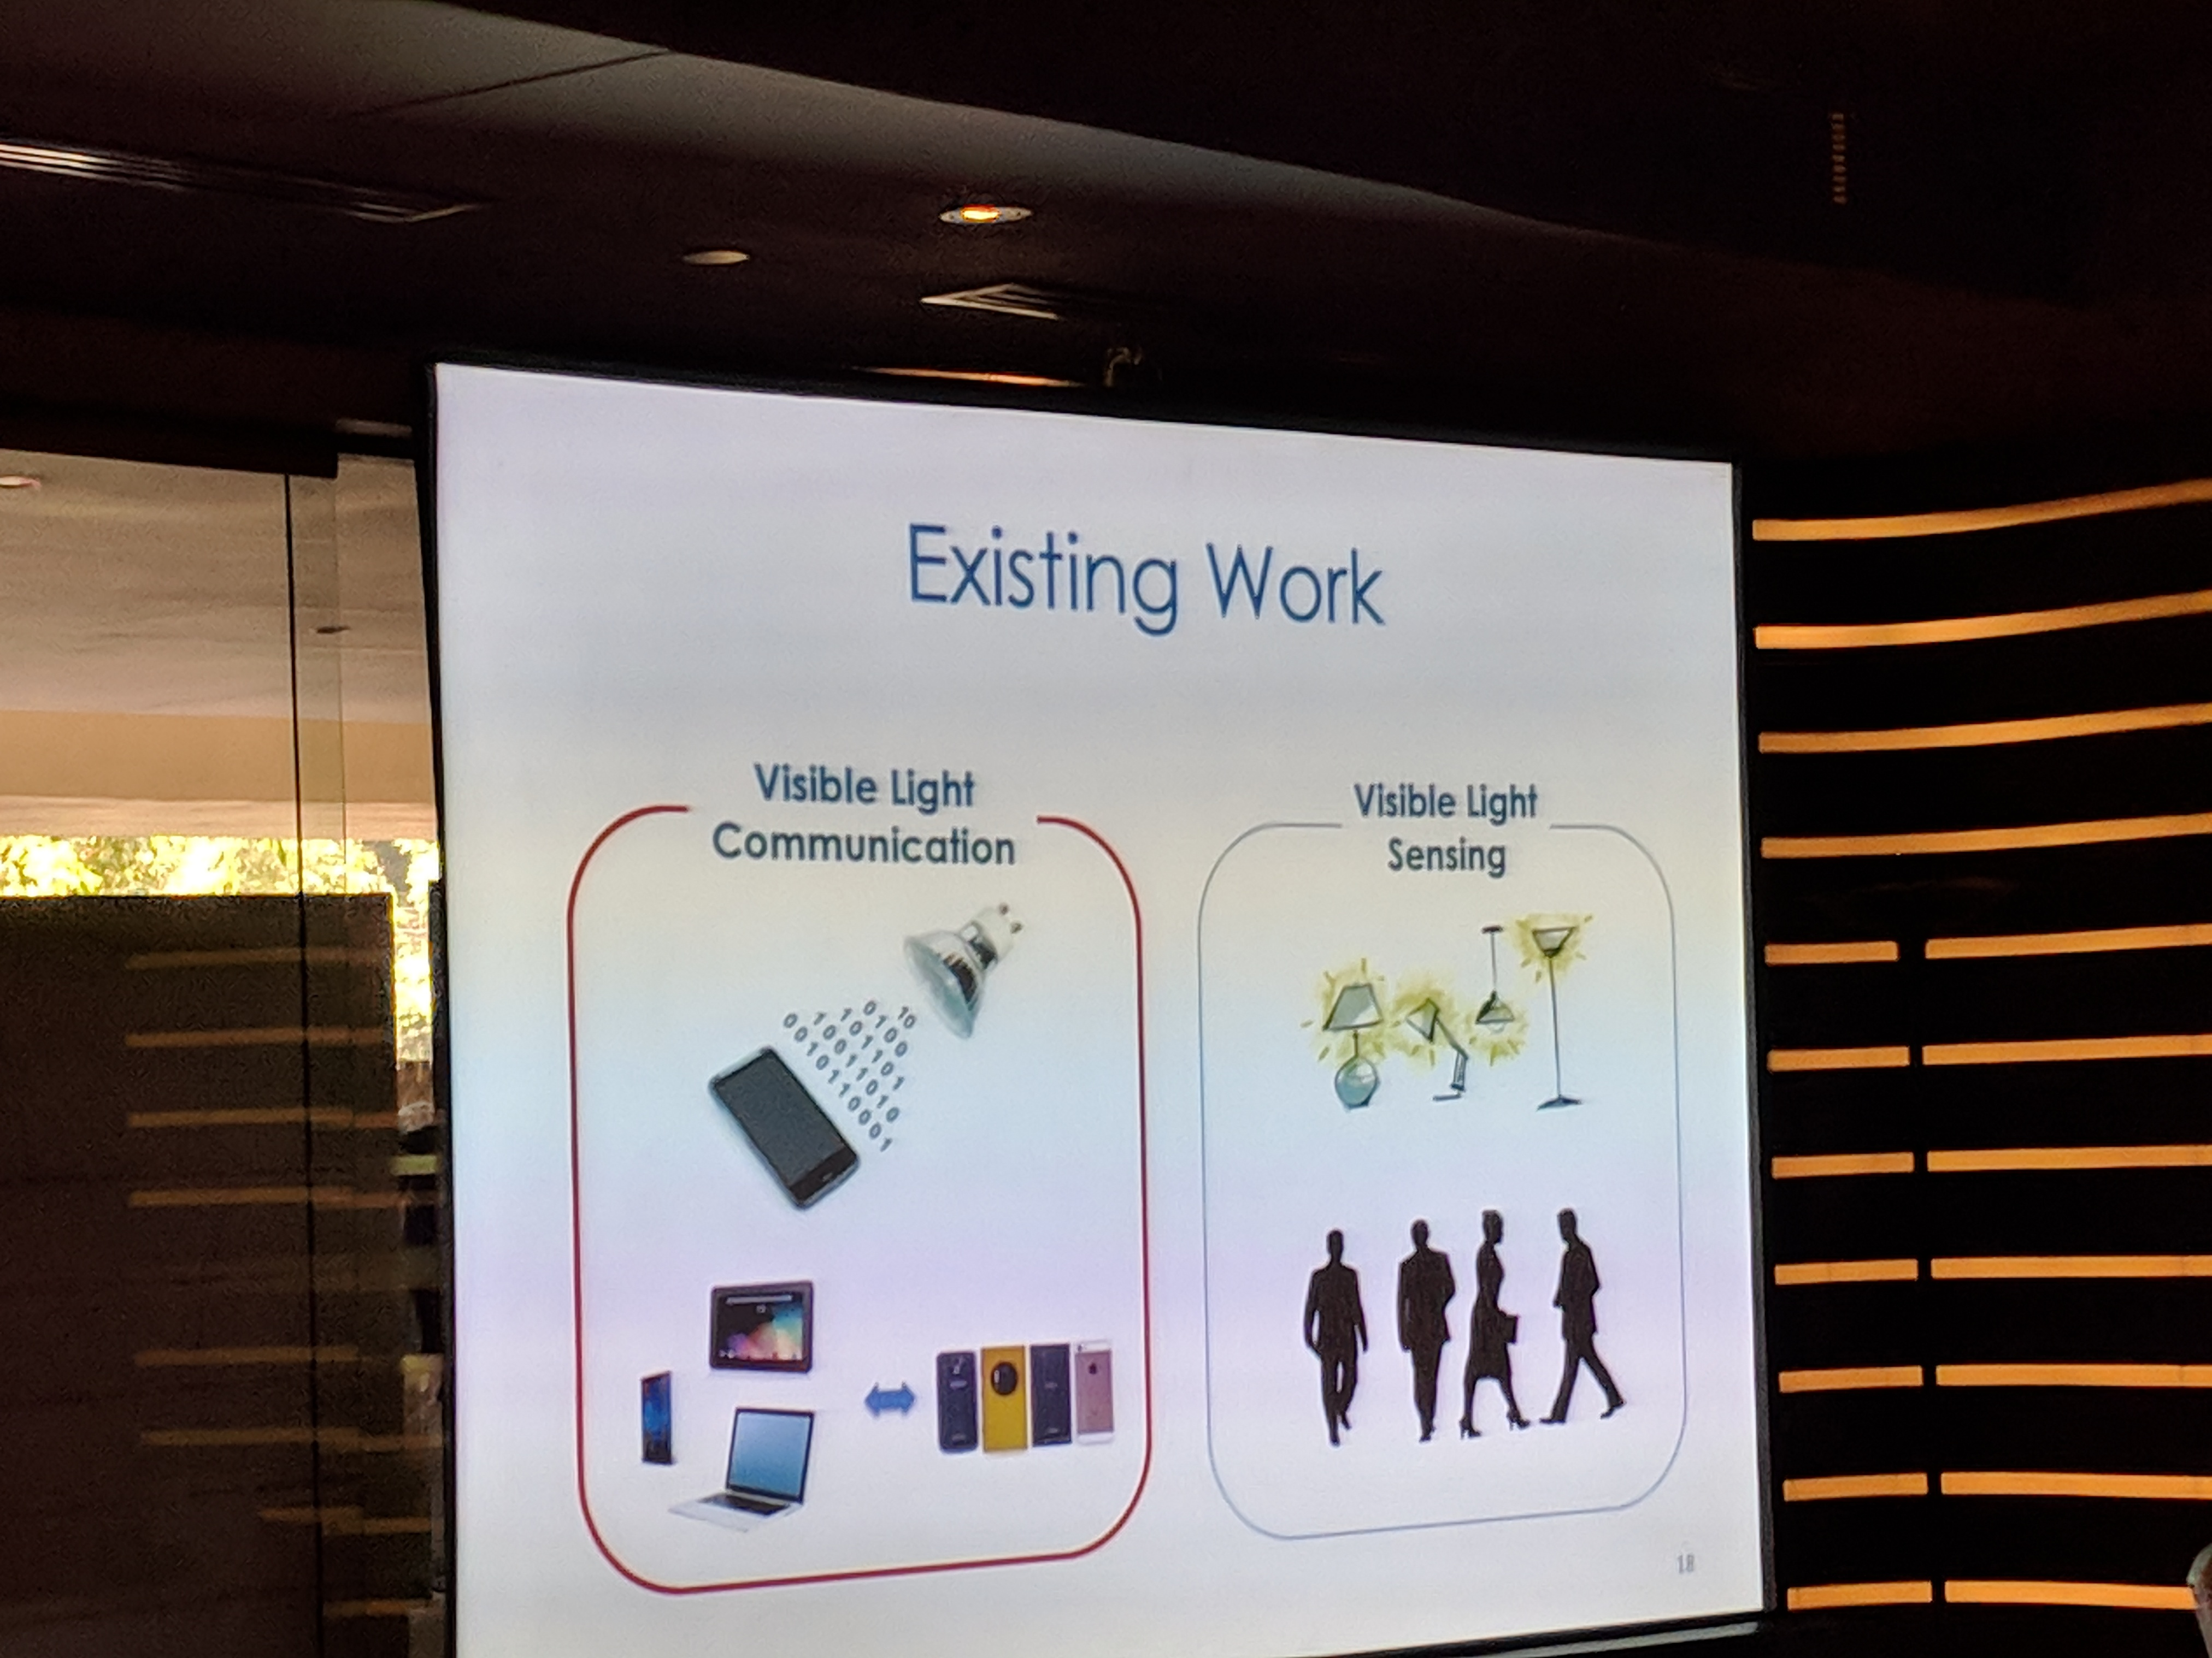
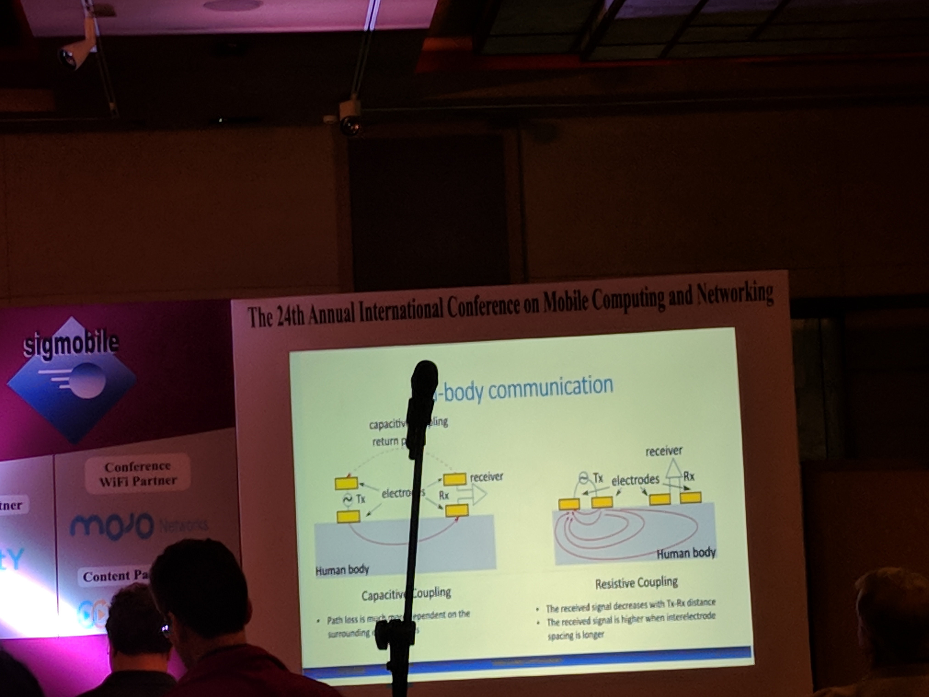
Other: Many Topic Preview Sessions

Slide 14
UbiComp 2018
8th – 12th October, 2018

Slide 15
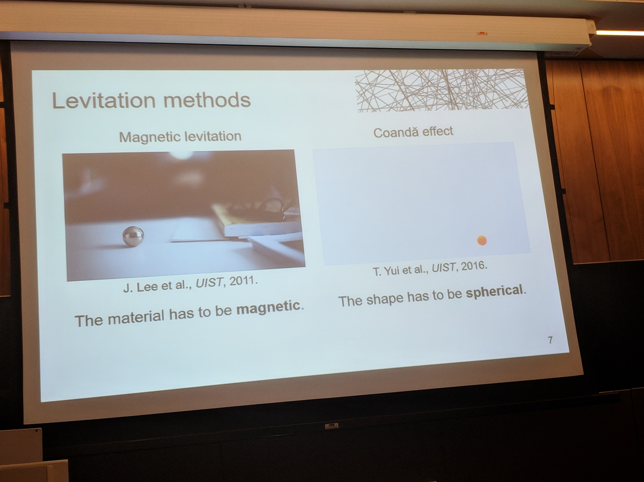
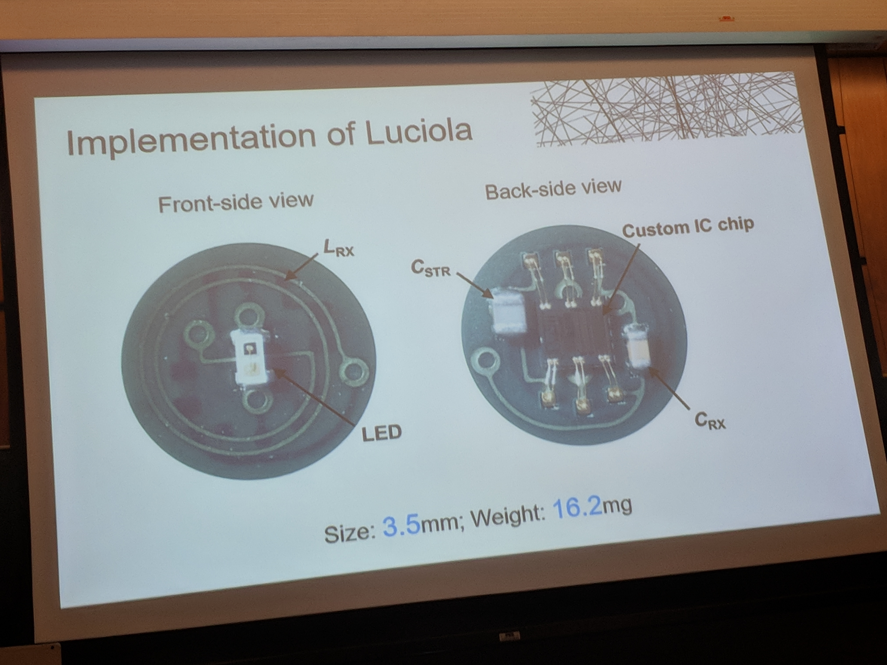
P1: Luciola: A Millimeter-Scale Light-Emitting Particle Moving in Mid-Air Based on Acoustic Levitation and Wireless Powering

Slide 16
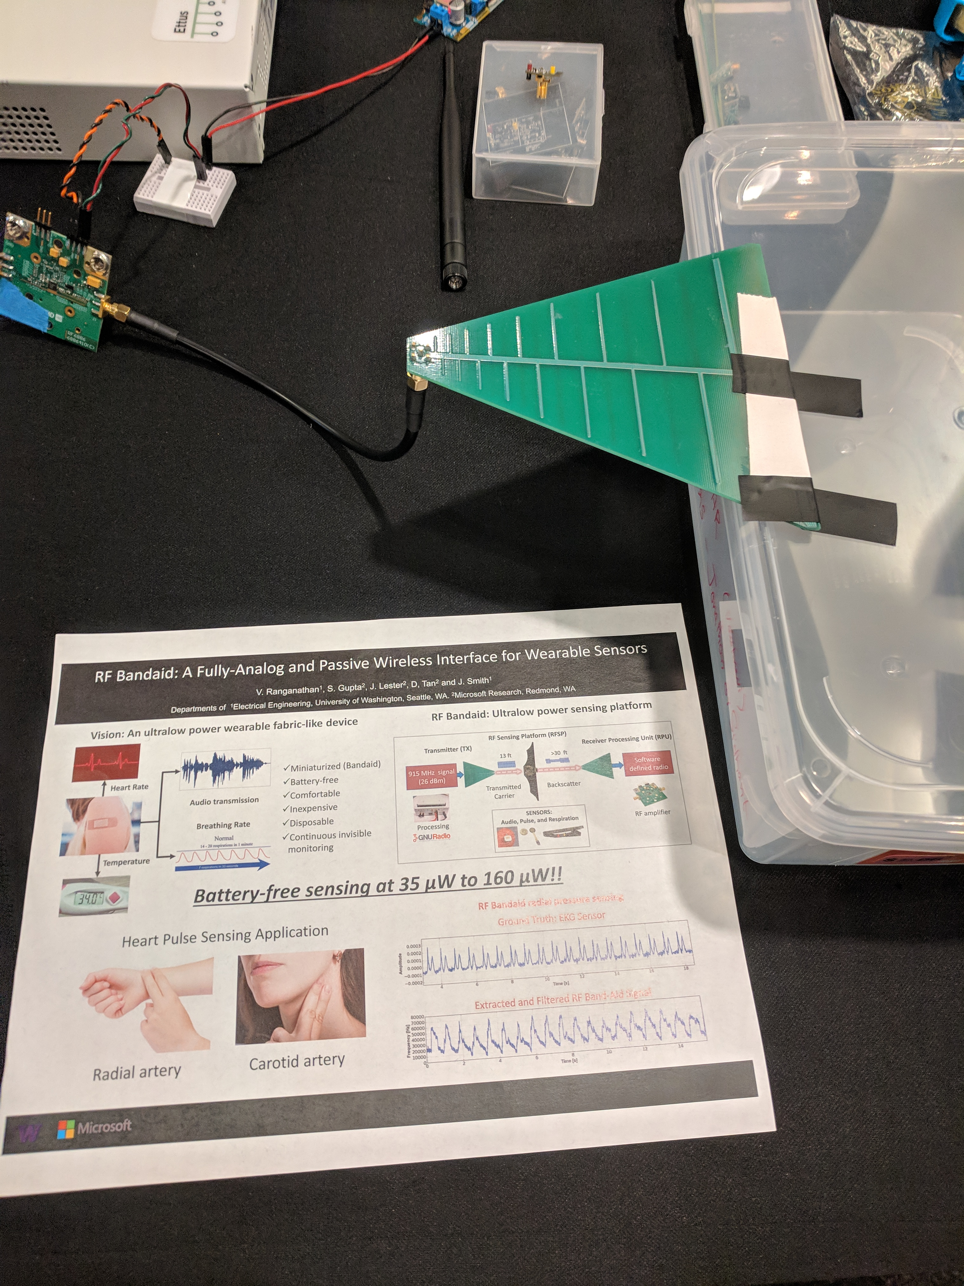
P2: RF Bandaid: A Fully-Analog and Passive Wireless Interface for Wearable Sensors

Slide 17
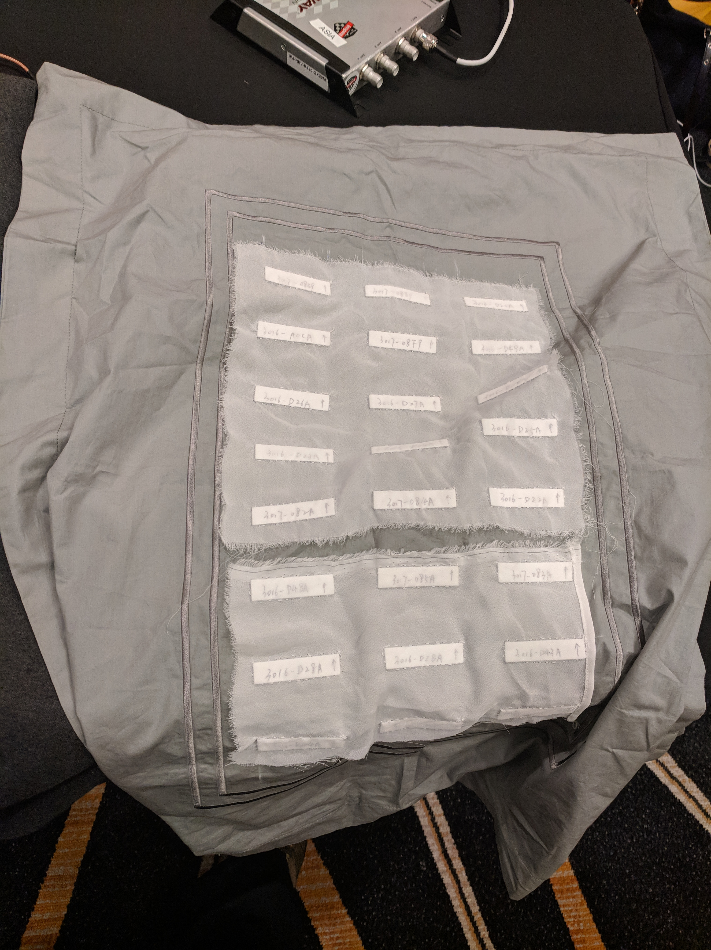
P3: RF-Kinect: A Wearable RFID-based Approach Towards 3D BodyMovement Tracking
Notes:
Towards Wearable Everyday Body-Frame Tracking using Passive RFIDs

Slide 18
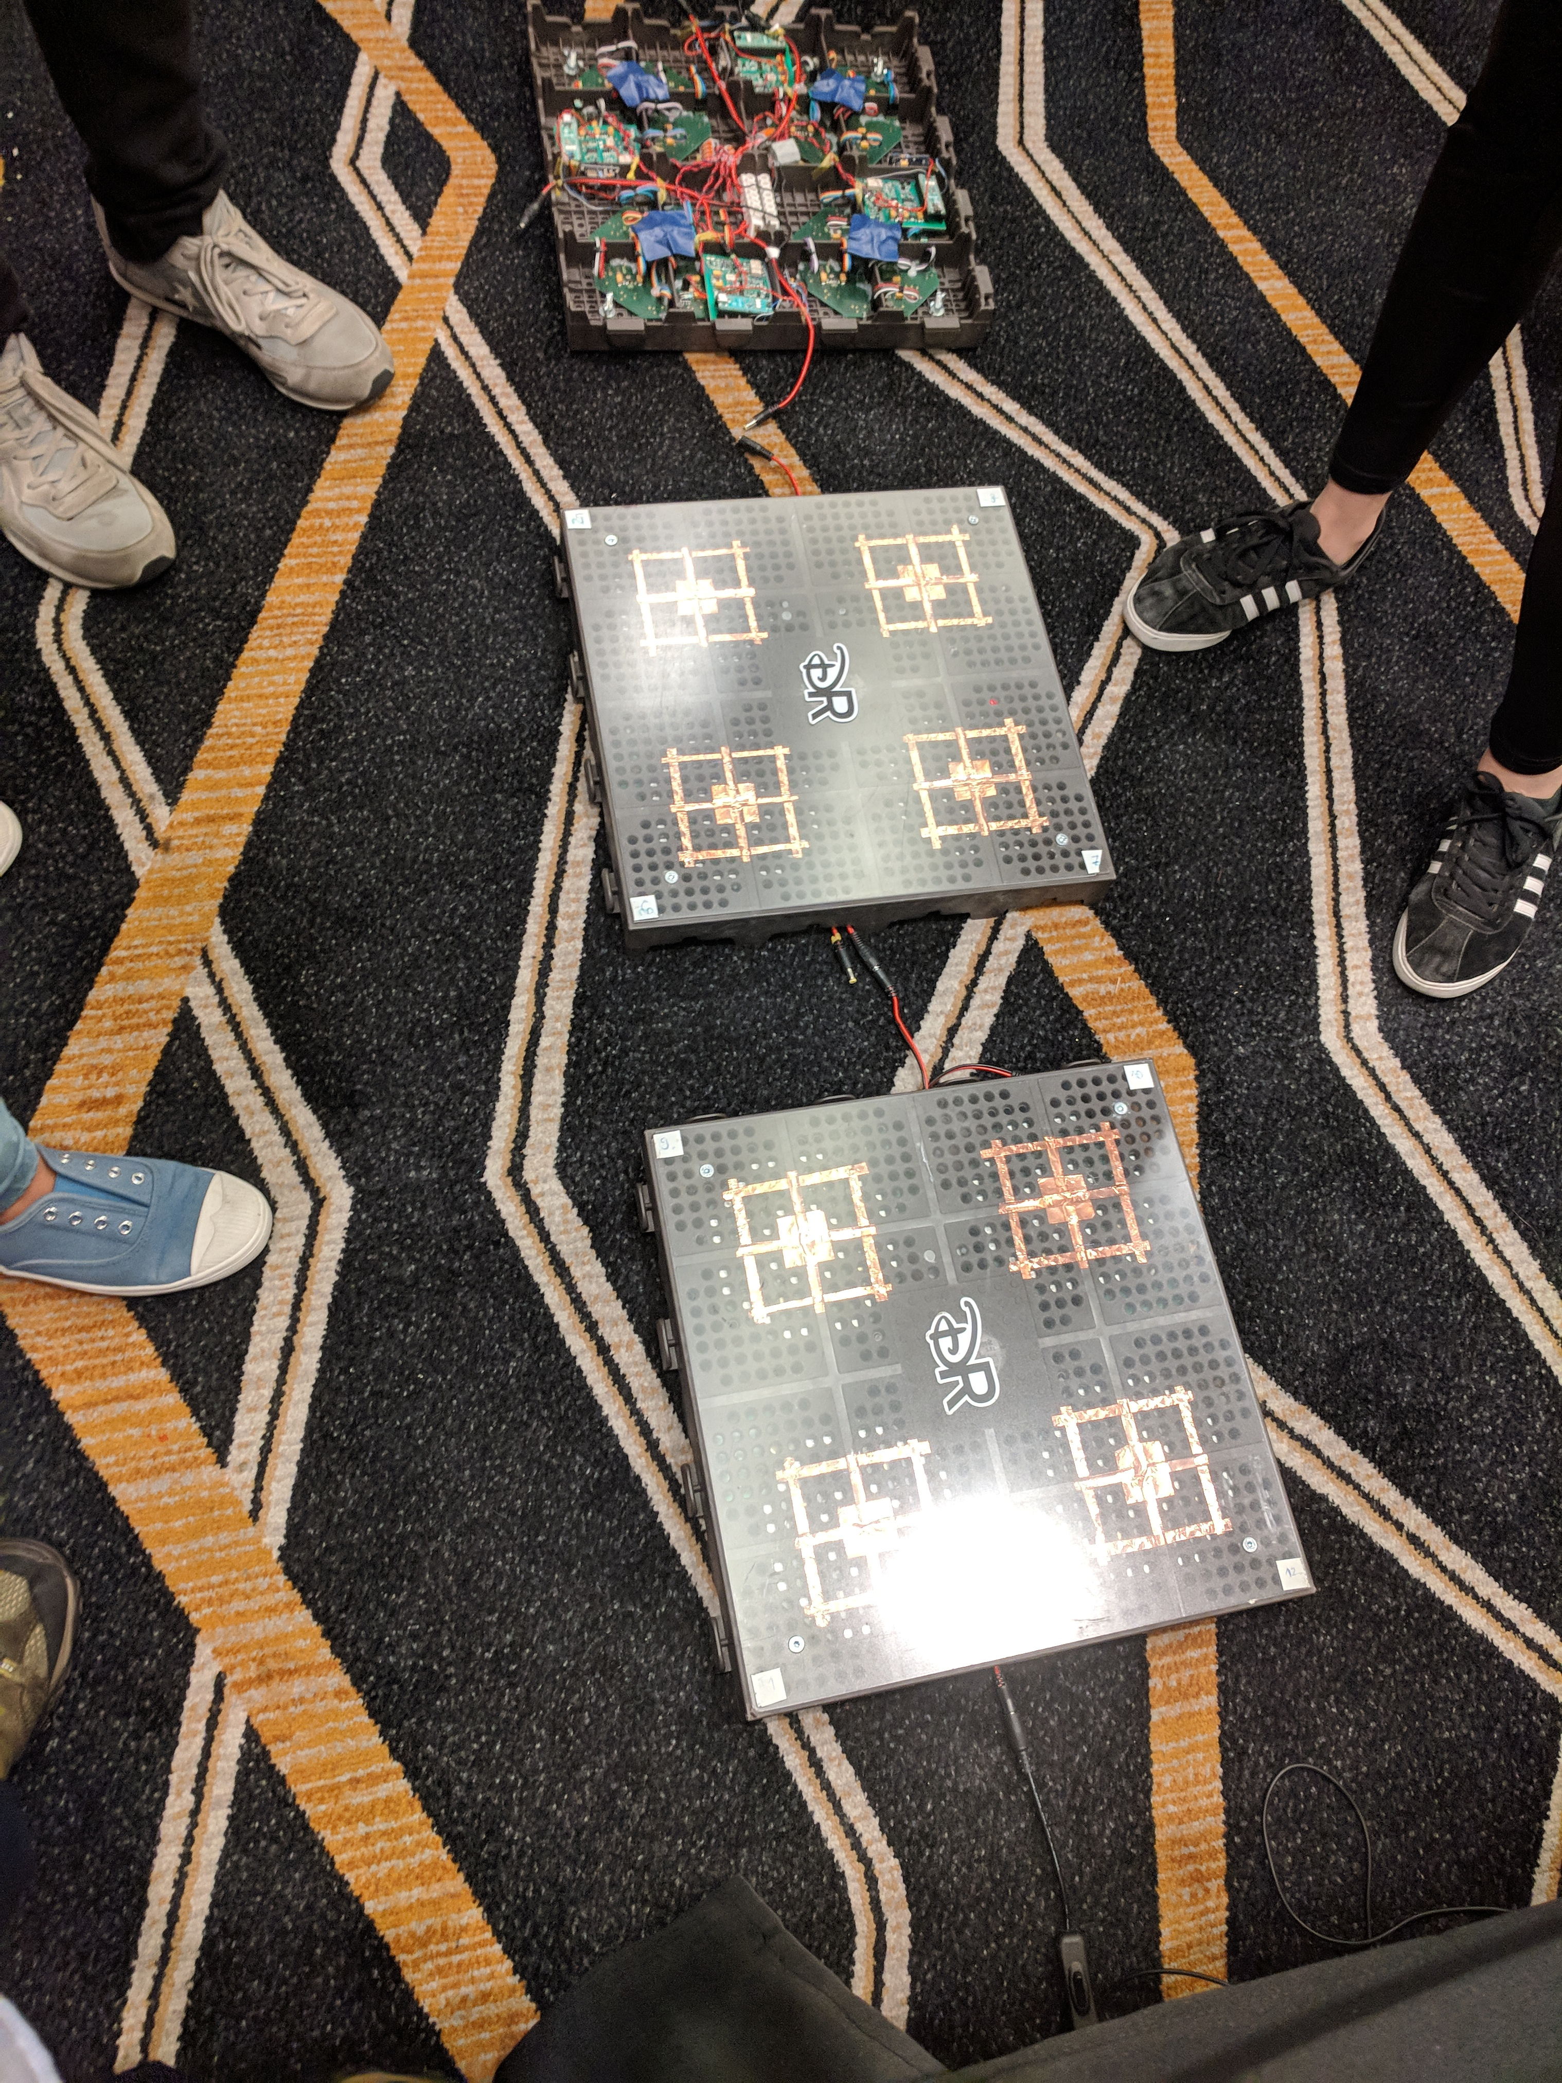
P4: Enabling Interactive Infrastructure with Body Channel Communication

Slide 19
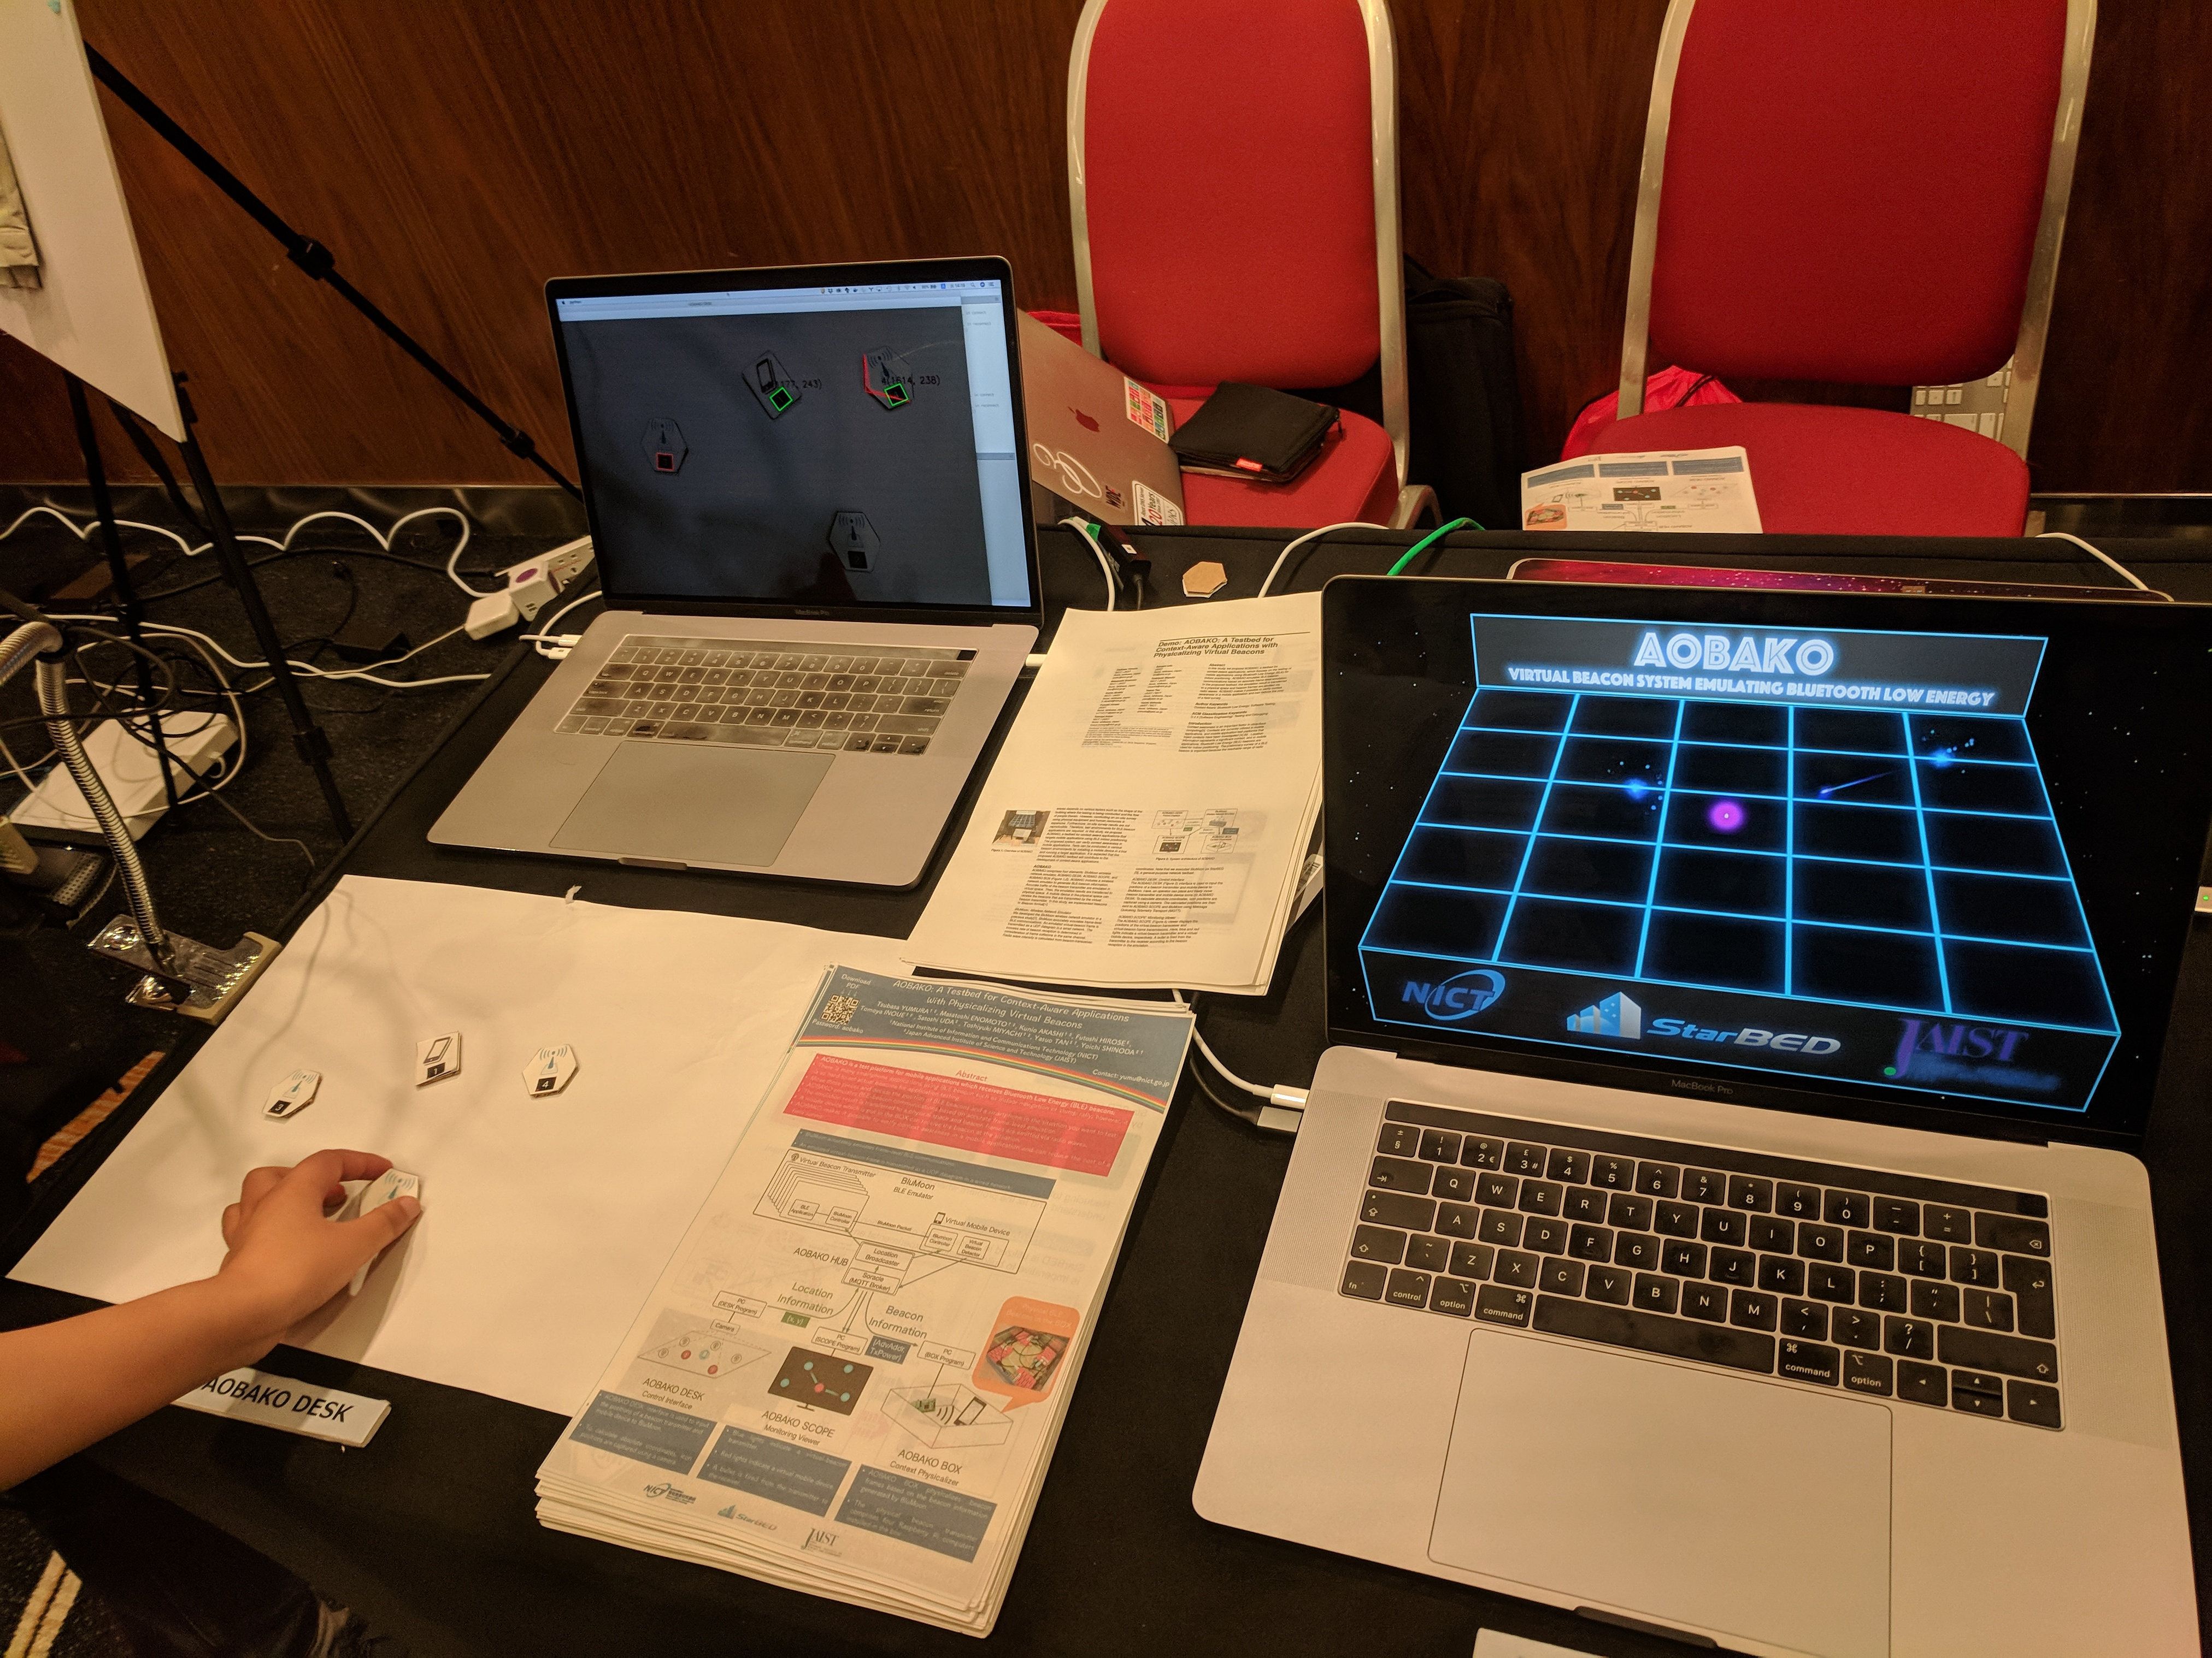
P5: iDial: Enabling a Virtual Dial Plate on the Hand Back for Around-Device Interaction

Slide 20
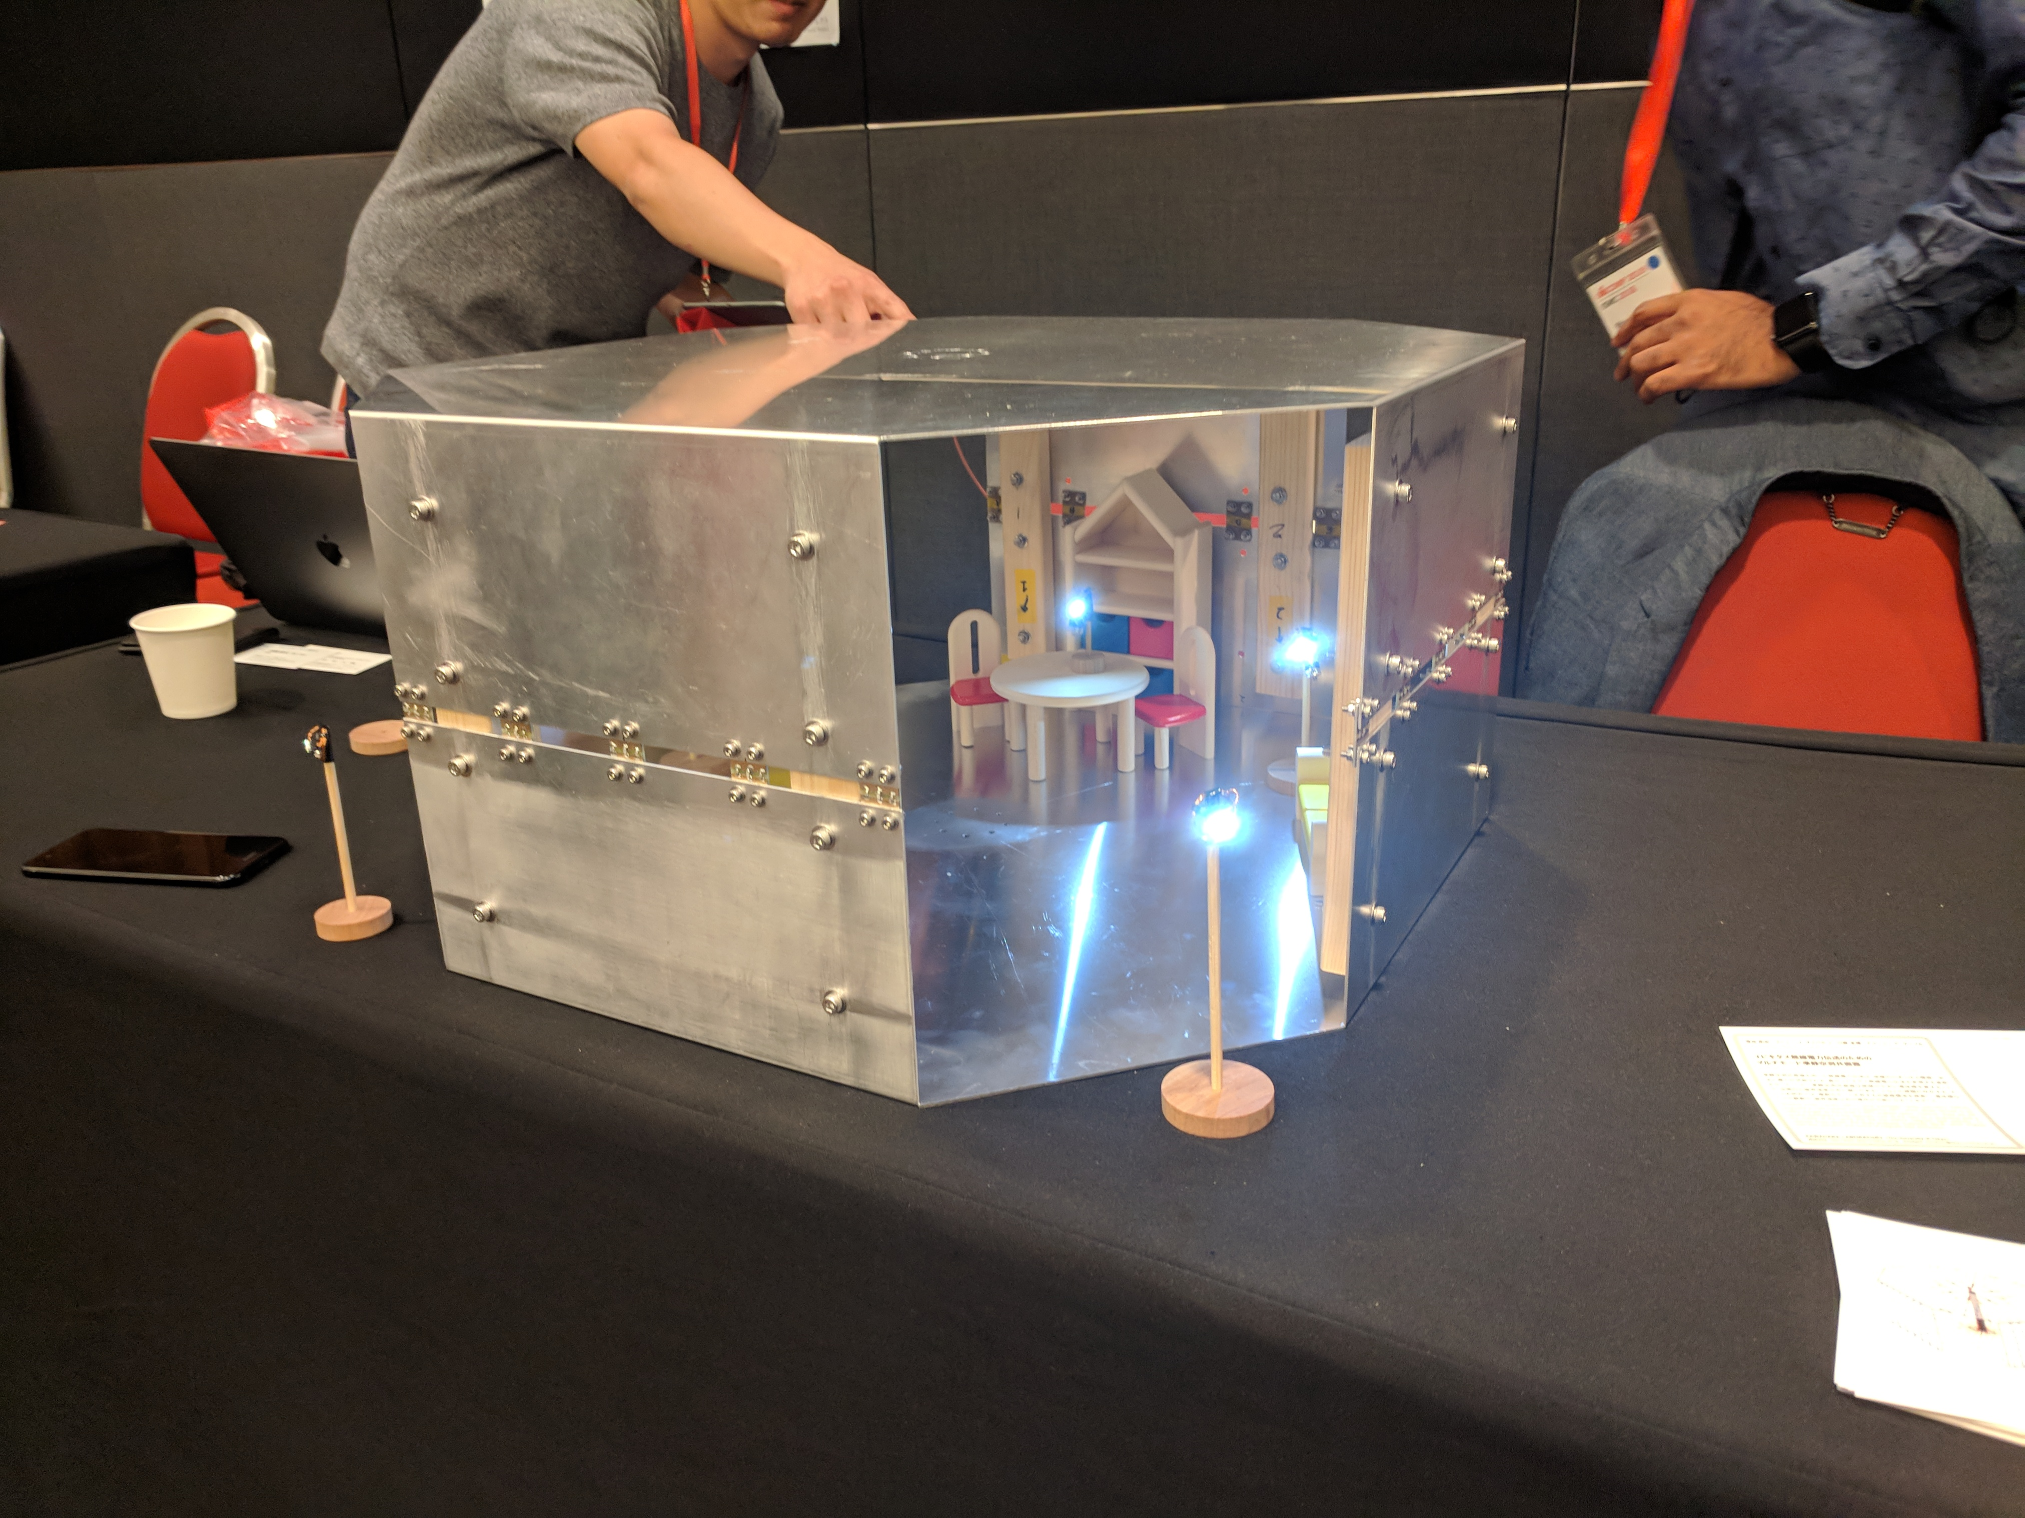
P6: Energy-Ball: Wireless Power Transfer for Batteryless Internet of Things through Distributed Beamforming

Slide 21
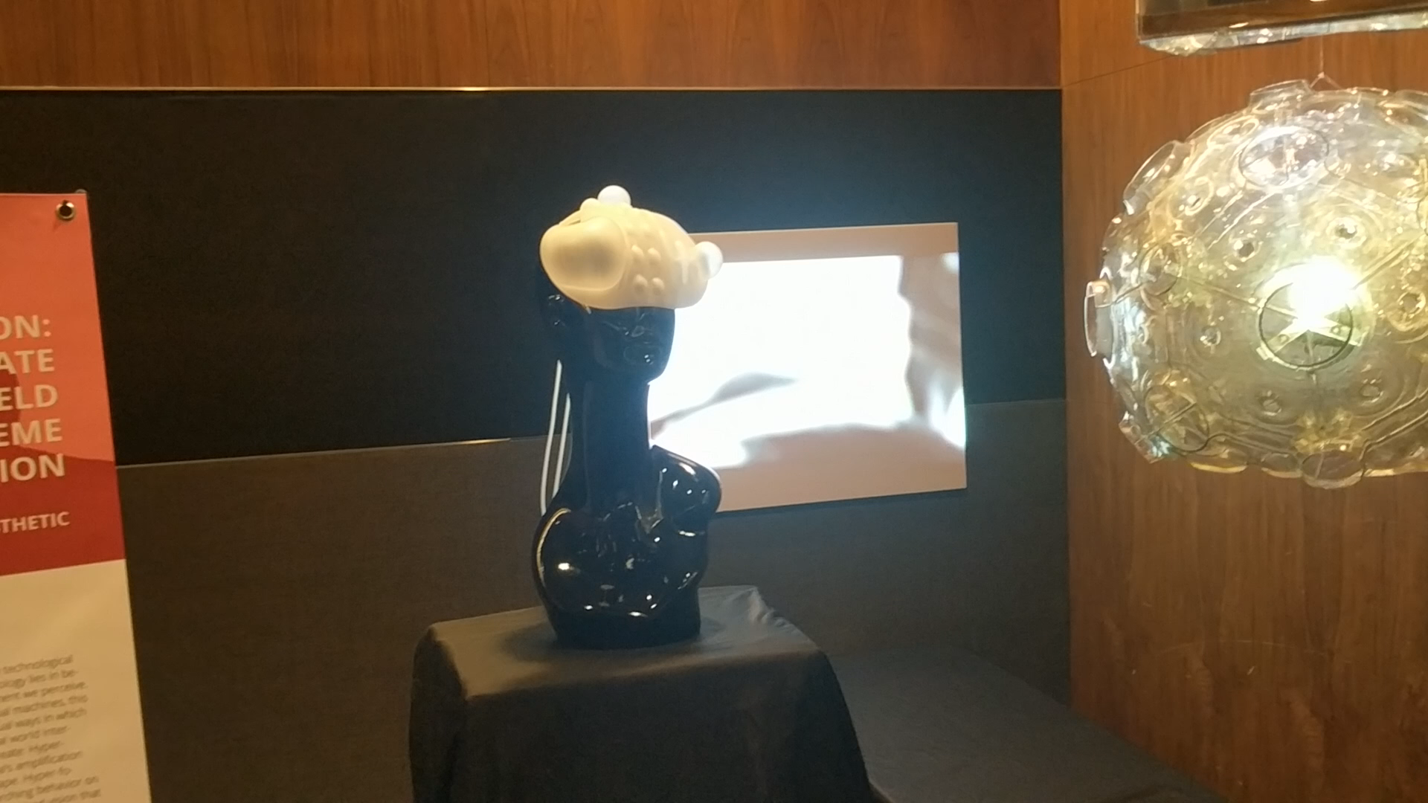
Other: Fashion Designers show Interesting Stuff !!

Slide 22
Other: Many Indoor Localization and Authentication Papers to keep count of !!

Slide 23
Thanks

